Slide 1

PowerPoint Poster Making 101
Instructional and Brand Guidelines for Stony Brook Children’s Hospital

Slide 2
Poster Considerations
The following guide was designed to assist you with formatting and printing your poster presentation while using the system-wide brand guidelines of Stony Brook Children’s Hospital.
PowerPoint was designed to project large images in a dark room. The amount of copy, images and colors that work well for slides don’t necessarily work for a poster.

Slide 3
Word Count: under 500 words
A poster is not a paper.
A paper is constructed for independent learning.
A poster by contrast has YOU standing next to it as its guide.
Your entire poster should have under 500 words total.
If your poster is clear and concise, an individual should be able to read it in under 10 minutes.
Always remember your target audience!

Slide 4
Visual Components
Every image is important.
Images should be legible from a distance. Clean and precise images are easy to see and understand.
Use charts, graphs and tables
Excel imports are common. If import problems occur, save the image in a pdf format, then import to PowerPoint.
Use clear photographs and/or illustrations
Save these images in a pdf or jpg format (300 dpi is recommended).
For best printing results, the original photograph or illustration should be 12” wide at 300 dpi. It is not recommended to enlarge these images or to download low resolution images (72 dpi) from the Internet. Visual quality will be compromised. If the image looks blurred when imported to your poster, it will print this way as well.

Slide 5
Poster Dimensions
PowerPoint templates provided are both horizontal 42” x 36” and vertical 36” x 42” orientations.
Horizontal
Vertical
The paper available for printing is 42 inches.
Note: Posters more than 42 inches are considerably more expensive to print.

Slide 6
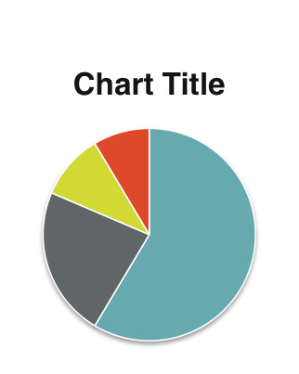
Layout of Poster
CH Logo
Header
Title Author(s)
Logo
(optional)
Column 1
Column 2
Column 3
Abstract
Results
Conclusion
Introduction
Literature Cited
Materials and Methods
Acknowledgements

Slide 7
Poster Components
Title: Convey the issue under study and draw passersby to your poster.
  Derive it from your hypothesis.
  Should not be greater than two lines.
Introduction: Use the absolute minimum amount of background information.
  Set the context of your study and draw your audience in.
  State your hypothesis clearly.
  Remember, less is more
Materials and Methods: Briefly describe experimental procedures, patient population, statistical analysis, etc.
  Section may be omitted if sufficient detail is included in figure/table legends.

Slide 8
Poster Components
Results: Use tables and figures to present your findings.
  Clinical research usually begins with a flow chart describing patient recruitment and a table of demographics for subjects included in the analysis.
Conclusions: Restate the significant findings of your study and the relevance of the results.
  Affirm or reject your original hypothesis.
  Discuss future directions.
Literature cited: Stick to one bibliography format for all listed references.
  Limit the bibliography to a maximum of 10 references.
+/- Acknowledgments: Include the names of all people who helped with the work but were not included as authors.
  List sources of funding.
  Include a conflict of interest statement.

Slide 9
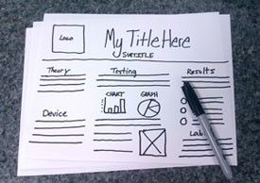
Getting Ready…
Draw a rough draft of your poster’s components.

Slide 10
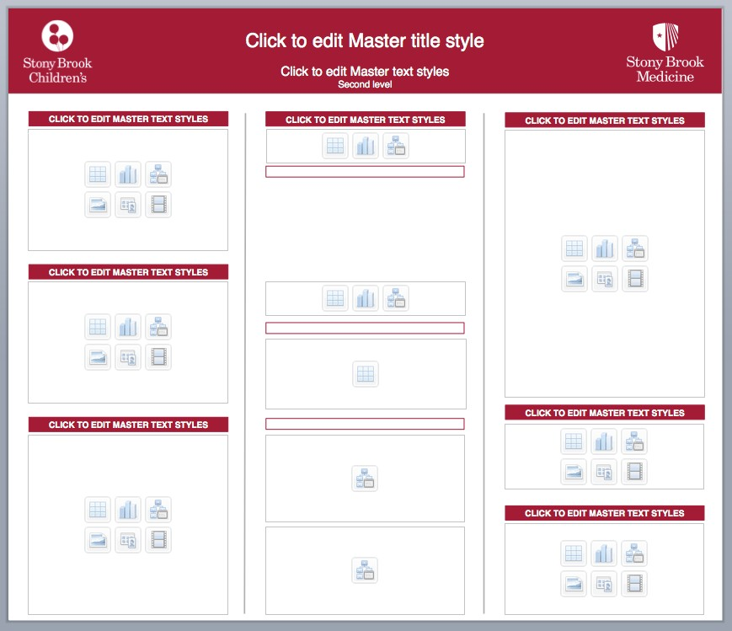
Download a Poster Template
The poster template choices for Stony Brook Children’s Hospital are:
SBCH 2015_VerticalTemplateOptions.potx and
SBCH 2015_VerticalTemplateOptions.potx

Slide 11
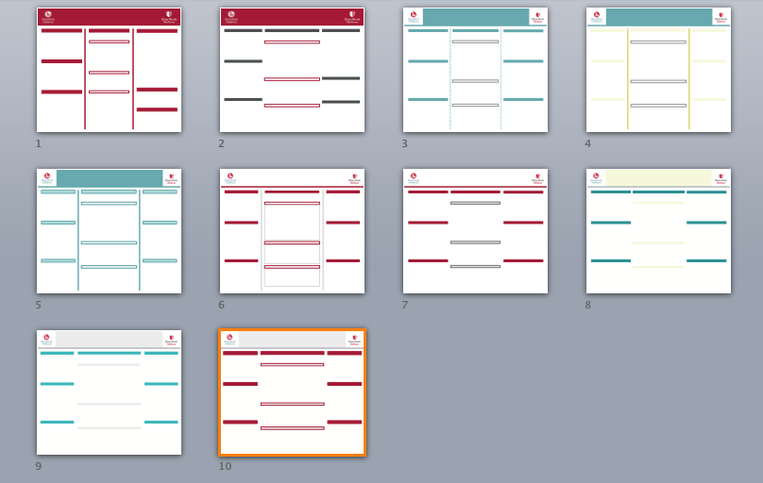
Horizontal Poster Options

Slide 12
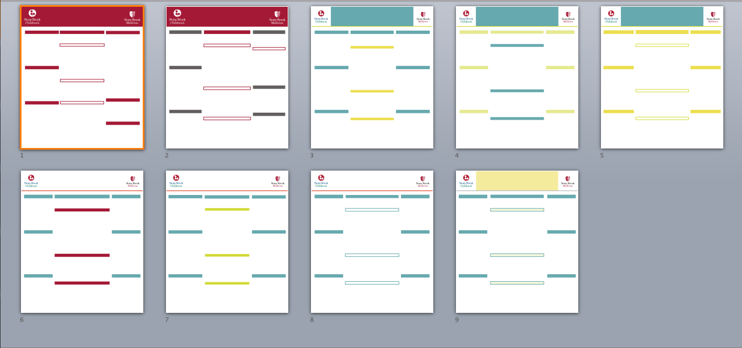
Vertical Poster Options

Slide 13
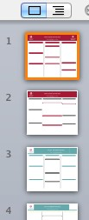
Choose a Poster Template
Choose one layout template
Delete all remaining pages when ready
If you need to add a slide, in the upper left corner of the document ribbon, Go to Home, New Slide, click and hold the drop-down arrow to the right of the (New Slide) icon.
Note: If you do not see the icon, click on the Home tab in the ribbon.

Slide 14


SBCH Color Palette
Correct usage of the
Stony Brook Children’s Hospital Graphic Standards Color Palette is vital for brand consistency.
Primary Colors
Secondary Colors
Tertiary Colors
Pantone |  | Black |  | Pantone |  | Pantone |  | Pantone |  | Pantone
187 |  |  |  | 7709 |  | Cool Gray 9 |  | 584 |  | 7652
Do not recreate or add to the Theme Color Palette.

Slide 15

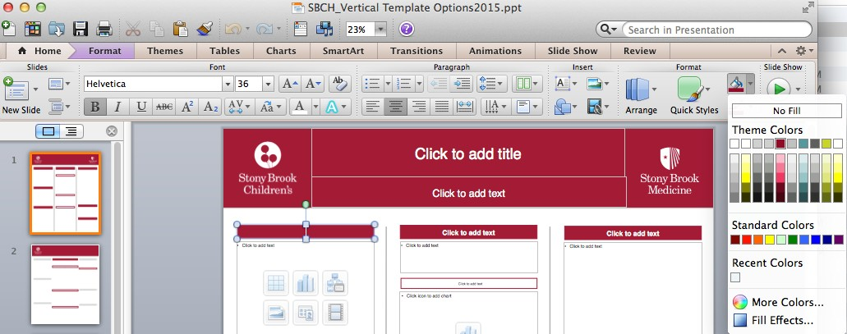




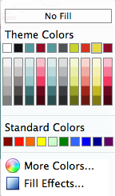
SBCH Theme Colors
Theme Colors have been set-up for you to use within PowerPoint and Excel. Go to the Ribbon’s Home Tab, Format and click on the paint bucket icon.
Ribbon
Theme Color Palette

Slide 16

Theme Color Palette Percentages
You are encouraged to use the Theme Color Palette with
color percentages for charts, graphs and tables – not text.
Primary Colors
Secondary Colors
Tertiary Colors
Black
Pantone 7709
Pantone Cool Gray 9
Pantone 584
Pantone 7652
Do Not Screen Pantone 187
Do not recreate or add to the Theme Color Palette.

Slide 17
RGB Color Palette
The RGB Color Palette breakdowns
listed below are for those using statistical software programs other than Excel.
Primary Colors
Secondary Colors
Tertiary Colors
Pantone |  | Black |  | Pantone |  | Pantone |  | Pantone |  | Pantone
187 |  |  |  | 7709 |  | Cool Gray 9 |  | 584 |  | 7652
RGB 184-18-55
RGB
46-191-202
RGB 105-108-116
RGB 214-220-41
RGB 240-78-37
Please note:
Use the SBCH color palette in this guide for all other software programs (Excel, PowerPoint, Word, etc.)

Slide 18
Font Recommendation
Helvetica
(Only Helvetica)

Slide 19



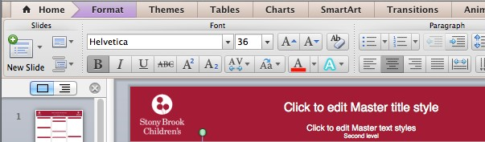
Font Color Options
The font Helvetica color choices are: Black, Red and White.
White
Choose only from the Theme Color Palette options.
White
White

Slide 20



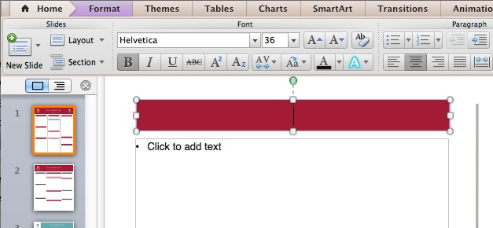
Font: Helvetica
Brand consistency is key. Only use the font Helvetica.
Use Regular, Italic, Bold, Bold Italic, CAPS regular and CAPS BOLD.

Slide 21

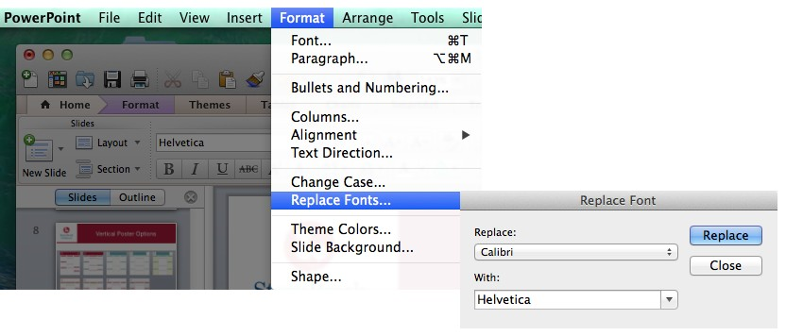

Replace Fonts to Helvetica
If your PowerPoint Template does not say “Helvetica” go to:
Format (drop-down menu), Replace Fonts, With: Helvetica, Replace.

Slide 22
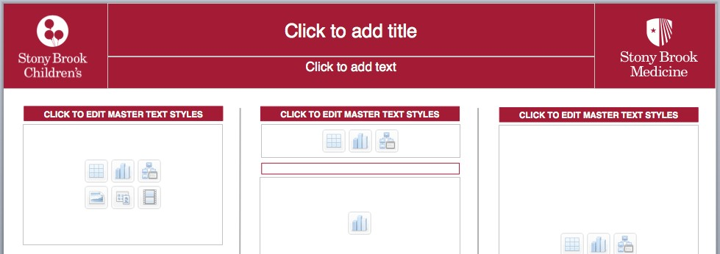
Font Sizes
Title: 85 point
Author(s): 54 point
Sub-Headings: 36 point
Body text: 24 point
Captions: 18 point
To be legible 14 feet use 72 pt.
To be legible 12 feet use 60 pt.
To be legible 10 feet use 48 pt.
To be legible 6 feet use 30 pt.
1
2
3
4
5

Slide 23
Colors: Can you read me now?
Can you read me now?
Can you read me now?
Can you read me now?
Can you read me now?
Can you read me now?
Can you read me now?

Slide 24
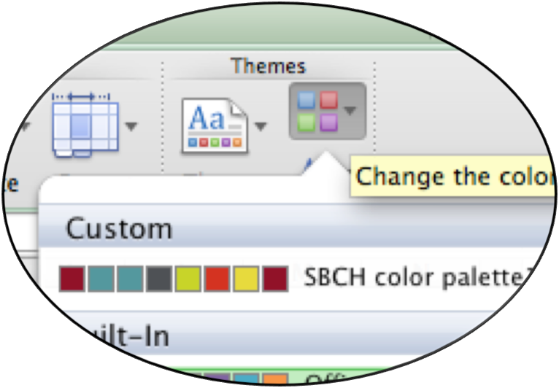
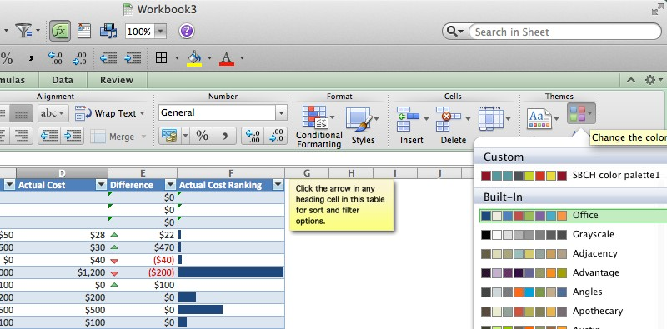




Working in Excel
Apply the SBCH Theme Color Palette to Excel charts, graphs and tables:
Double click on the
Home tab, Themes, Colors and choose Custom.

Slide 25









Working in Excel
An Excel file has been supplied for reference.
Budget Summary
Easily apply your own colors to this template. This template is formatted using themes that enable you to apply fonts, colors and graphic formatting effects throughout the workbook with just a click.
Projected Monthly Income
Income 1 | $6,000
Income 2 | $1,000
Extra income | $2,500
Total income | $9,500
Projected Monthly Expenses
#REF!
Actual Monthly Income
Income 1 | $5,800
Income 2 | $2,000
Extra income | $1,500
Total income | $9,300
Actual Monthly Expenses
#REF!
Select Themes on the Home tab.
File name: SBCH_Excel Poster Sample.xlsx
Balance (income - expenses)
Projected Balance | #REF!
Actual Balance | #REF!
Difference | #REF!
Choose the four-square icon on the right and click on Custom SBCH color palette1.
Expense Overview
Budget Categories | Values
 | Total Cost | % of Expense
Food | $1,200 | 25.93%
Groceries | $0 | 0.00%
Dining Out | $1,200 | 25.93%
Transportation | $850 | 18.37%
Housing | $840 | 18.15%
Insurance | $800 | 17.29%
Gifts and Charity | $700 | 15.13%
Personal Care | $140 | 3.03%
Entertainment | $98 | 2.12%
Loans |  | 0.00%
Pets |  | 0.00%
Children |  | 0.00%
Taxes |  | 0.00%
Savings or Investments |  | 0.00%
Grand Total | $4,628 | 100.00%
Food Groceries Dining Out Transportation Housing Insurance
Gifts and Charity Personal Care Entertainment Loans
Pets
Excel file example
Children

Slide 26
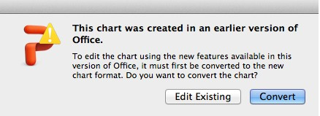
Edit Charts, Graphs and Tables
You can adapt the color and font format theme within PowerPoint for your Excel charts, graphs and tables.
There are two options:
Double click on the Chart, Graph or Table
Choose Edit Existing or Convert

Slide 27
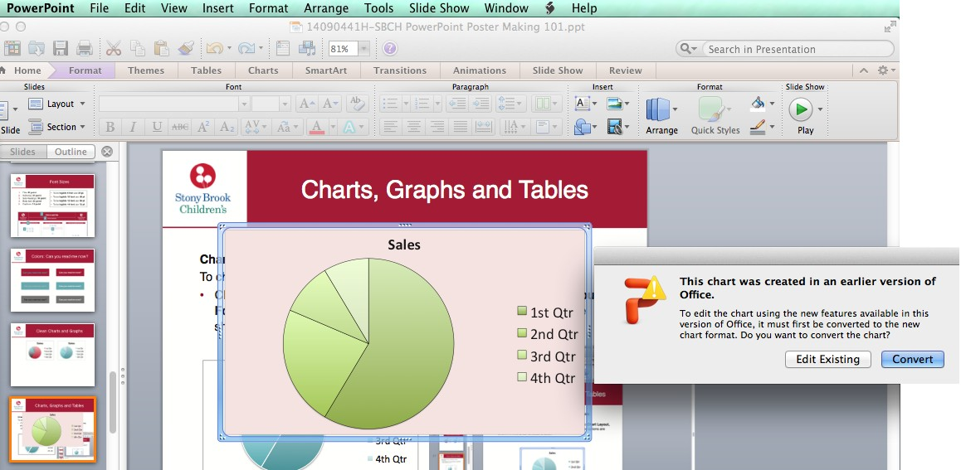
What is Edit Existing and Convert?
Edit Existing: Allows you to modify an original Excel file. Convert: Allows you to convert the original Excel file to PowerPoint’s theme and color palette options.
Chart example

Slide 28

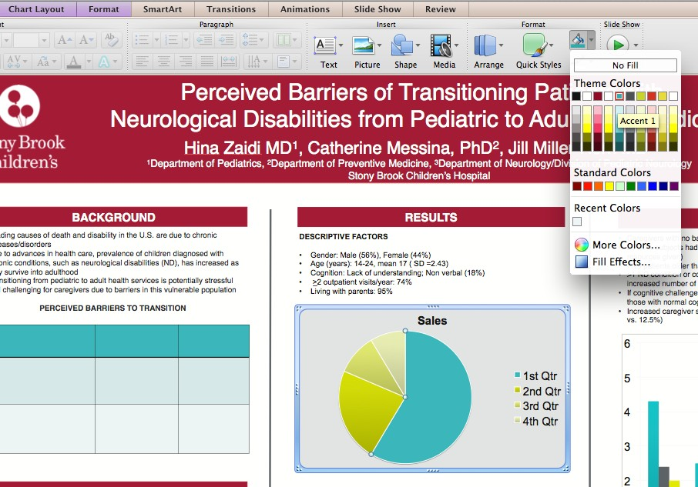


Convert Images with Fill Color
Custom color “Converted” images:
Click on the inner image. The section will be highlighted.
Go to Fill Color
(paint bucket icon).
Choose an Accent Color from the Theme Colors palette.
Chart example

Slide 29
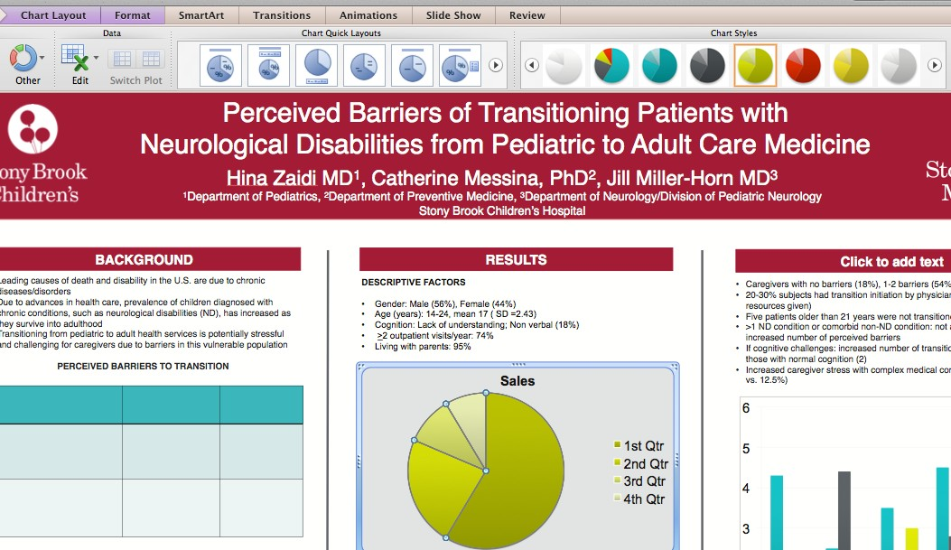

Convert Images with Chart Styles
Custom color “Converted” images:
Click on the graph. The section will be highlighted.
Go to Chart Layout, Format, Chart Styles.
Choose a chart style from the SBCH Theme Color Palette.
Chart example

Slide 30

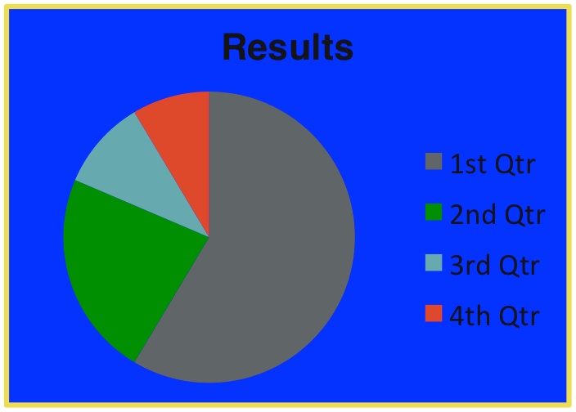
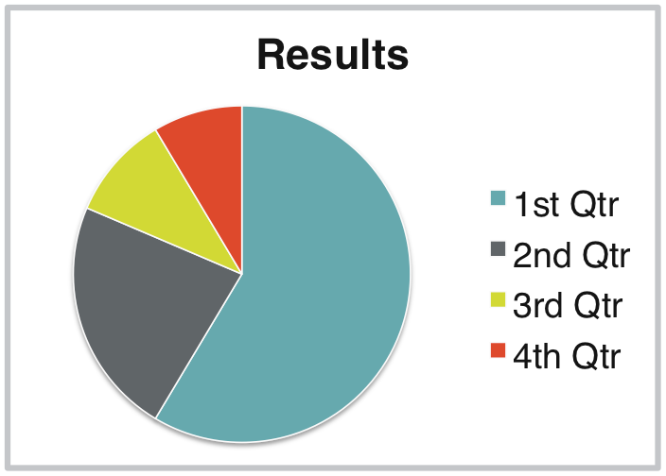
Charts
Charts should be LARGE and as simple as possible.
Always use a 3 point, gray rule outer box with a white background.
•
Use black text.
Bad
Good
Chart example

Slide 31
Graphs
Graphs should be LARGE and as simple as possible.
•
Use black text.
Always use a 3 point, gray rule outer box with a white background.
Bad
Good
Mouse 119 (Both Flanks: SK (Job) LCL concentrated)
Tumor Development and Regression
300
Tumor size (mm squared)
Tumor size (mm squared)
290
150
270
250
230
210
190
100
170
Le. ﬂank Right Flank
150
Le. ﬂank Right Flank
130
110
50
₈90
₆70
₄50
₂30
10
0
0 5101520253035404550556065707580
Days Post-Injection
0 20 40 60 80
Days Post-Injection
Graph example

Slide 32
Figures
Be sure to include a brief caption for your figures, and explicitly refer to the figure in the text.
When adding an image to your poster, use a
3 point, gray rule border with a white background. This will give the image a clean “framed” look.
All text associated with a figure image must be in black.
Black text within figures reads best from a distance.

Slide 33

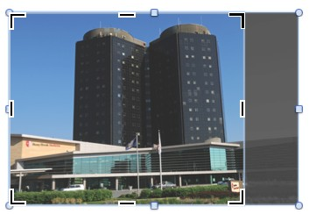
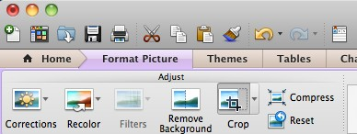

How to Crop an Image
Using the crop tool will not distort (stretch or elongate) your image.
Highlight the image, go to the Ribbon area, Format Picture, Crop.
Photo example

Slide 34
As You’re Putting It All Together
EMPTY PHRASE | EQUIVALENT
a majority of | most
a number of | many
accounted for by the fact that as a consequence of due to the fact that in view of the fact that for the reason that on account of on the basis of on the grounds that owing to the fact that | because
an order of magnitude | ten times
are of the same opinion | agree
at the present (moment) at this point in time | now
by means of | by, with
despite the fact that | although
during the course of | during, while
fewer in number | fewer
for the purpose of | for
has the capability of | can
having regard to | about
if conditions are such that | if
in all cases | always, invariably
in close proximity to | near
in connection with | about, concerning
in my opinion it is not an unjustifiable assumption that | I think
in order to | to
in the event that | if
it is clear that | clearly
it is often the case that | often
it is possible that the cause is | the cause may be
it is worth pointing out that | note that
it may, however, be noted that | but
lacked the ability to | could not
large numbers of | many
prior to | before
Tips for Good Writing 
1. Create sentences that use carefully chosen subjects and vigorous verbs to express your central meaning.
2. Omit needless words and empty phrases.
3. Use definite, specific, and concrete language, avoiding overuse of abstractions and technical jargon (including abbreviations).
4. Use the active voice and active constructions as much as possible.
5. Keep related words together. Subjects should be close to their verbs, and modifiers close to the words they modify.
6.Express coordinated ideas in a similar form. Parallels in meaning are reinforced by parallels in structure.
Taken from Constance Baldwin workshop (2018) “The Nuts and Bolts of Scientific Writing”

Slide 35
Getting Your Poster Printed
Institute for STEM Education (I-STEM)
Format posters as Powerpoint slides: 42w x 36h inches
Acceptable formats are PowerPoint and PDF
Mac users, please save as pdf if possible
Posters will only be accepted via email (NOT flash drives). Email file to:
posterprinting@stonybrook.edu
You do not have to pay for printing. Your name will be on a list of approved submissions – Indicate to I-STEM staff that you are part of Stony Brook Pediatrics when you submit file for printing.
For Poster Formatting Instructions, go to:
https://www.stonybrook.edu/istem/poster_printing_services/index.php
Location of I-Stem: In the Life Sciences Building basement level, Room 092 (to the left when you go down the stairs or elevator from the lobby).

Slide 36
Timeline to Research Day
April 17 Poster Workshop
April 24 Two Minute Talk Workshop (10 – 11 am)
May 10 Send draft of poster to:
Your Mentor
Your RSOC Liaison
(MJE)
May 15 Receive and incorporate edits
Get okay from your Mentor before printing
May 20-24 Poster printing at I-STEM (Email file)
May 28 All posters dropped off at T-11-069 (MJE Lab)
May 29 Research Day - Present poster to judging panel

Slide 37
What to Expect
Based on 2018 Research Day
8:00 – 8:30 Registration and Breakfast – Theater Lobby
8:30 Welcome –- Dr. Margaret Parker
Chair’s Opening Remarks - Dr. Carolyn Milana– Main Theater
8:40 Keynote Address – Main Theater
Introduction of Keynote Speaker – Dr. Andrew Lane
8:45– 9:35 Keynote Speaker: Susan Furth, MD, PhD
“Lessons Learned from the Chronic Kidney Disease in Children Cohort Study”
Platform Presentations – Main Theater
Session 1 (9:40-10:10)
9:40 Introduction of Invited Judges – Dr. Robert Parker
9:45 -10:10 Residents Platform Presentations (Chair – Dr. Robert Woroniecki)
Joseph Cafone, MD “US Adult University Rheumatologists Preferences and Knowledge Gaps Regarding the Care of Young Adults with Rheumatic Conditions”
Kathleen Murphy, DO “Rates of Blood Lead Screening and Barriers to Compliance in Stony Brook Primary Care Pediatric Offices”
10:15 – 10:30 Coffee Break - Theater Lobby
Session 2 (10:35 – 11:20)
10:35- 10:50 PEDs Talks (Introduced by Dr. Marian Evinger)
Daniela Feitosa, MD “What Were We Thinking?”
Jennifer Lutz Cifuni, DO “Dr. Patient: A Warrior”
10:55 – 11:20 Fellows Platform Presentations (Chair – Dr. Janet Fischel)
Aderonke Adefisayo, MD “Reception & Barriers to Long Acting Injectable Antiretrovirals (LA-ARV) for Pre-Exposure Prophylaxis (PrEP) in Adolescents”
Laura Stabin, MD “Regional Tissue Oxygenation in Term Infants with Presumed Sepsis”
11:20 – 12:15 Poster Session - Theater Lobby (Chair - Dr. Taly Glaubach)
Invited Judges plus Drs. Glaubach and Woroniecki
12:20 – 1:00 Lunch – Zodiac Gallery -Dr. Furth to discuss her academic career path
Presentation of Awards and Closing Remarks by Dr. Milana

Slide 38
This is how it all sorts out….
RESIDENT POSTER PRESENTATIONS
1 2 3 4 5
Poor Average Good Excellent Outstanding
 | TOPIC | Importance of Topic | Hypoth.-Driven | Methodol. Sound | Meaningful Results | Conveys Implications | Speaker Presence | Fielding Questions | TOTAL SCORE | Comments
RESIDENTS
TEAM A
J. Dunahay, MD, PGY-3 | Changes in Growth Trajectory Z Scores Predict VLBW Growth Outcomes
S. Heathcote, MD, PGY-3 | Obesity Ident. & Mgt in the Outpatient Setting
K. Louie, MD, PGY-3 | Improving High-Risk Clinic Compliance
N. Shin, DO, PGY-3 | Attrition Factors in Ped. Wt. Mgt. Ctr. Parents Perspect.
D. Feitosa, MD, PGY-2 | Riboflavin Transporter Deficiency (CR)

Slide 39
Best of Luck!
Stony Brook
Children's

