Slide 1
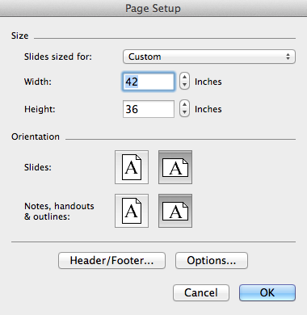
Important Information about Poster Resizing
This template was designed to be 42” wide x 36” high.
Although not recommended, if you must increase the poster size, follow these steps:
Go to File, Page Setup, Width and Height.
Check with your printer for paper size availability and cost increase.
Change both the Width and Height to increase the paper by 5%, 10% or 15% using the specific dimensions here:
5% - 44.1” w x 37.8” h
10% - 46.2” w x 39.6” h
15% - 48.3” w x 41.4” h
Note: DO NOT simply change the paper size of the template, as all linked logo(s) and images will be distorted, resulting in poor branding practices.

