Slide 1
Stony Brook
Sports Medicine
Department of Orthopaedics
A Hands-on approach
to ACL Prevention
in Female Athletes
November 17, 2020 7pm
The 10th Annual Stony Brook Sports Medicine Webinar series brought to you by Stony Brook University & The Women’s Sports Medicine Center. Thank you for joining us this evening, we will begin shortly.

Slide 2
Course Description:
The Stony Brook Department of Orthopaedics would like to welcome you to this webinar. Throughout this presentation time, we will be educating the viewers on current best practices on the reduction of knee injuries among athletes of all ages, provide information on preventive strengthening with the ACL Prevention Program, and introduce the Stony Brook Women’s Sports Medicine Center team.

Slide 3
*Important*
Reminder: To receive your educational credit for this webinar you must be logged in with your full name and credentials so we can verify attendance. Ex: Dana Bennett, ATC., Jane Doe, MD.
*This meeting is being recorded for future use*
Please make sure your video and microphone remain off during this presentation.

Slide 4
Objectives:
-Understand the current best practices on the reduction of knee injuries among athletes of all ages.
-Identify and implement the "Stony Brook University ACL injury prevention program" through multidisciplinary presentation via webinar.
-Identify the prevention program steps and understand how to implement the program for themselves and/or their athletes.
-Allow community members to ask questions about a novel ACL injury prevention program to enhance their ability to implement such a program.

Slide 5
Accreditation:
CME
The School of Medicine, State University of New York at Stony Brook, is accredited by the Accreditation Council for Continuing Medical Education to provide continuing medical education for physicians. The school of Medicine, State University of New York at Stony Brook designates this live activity for a maximum of 1.00 AMA PRA Category 1 Credit(s).™ Physicians should only claim the credit commensurate with the extent of their participation in the activity.
Please contact the Stony Brook School of Medicine Office of Continuing Education at 631-444-2094 to speak with Myra or Donna with CME questions.

Slide 6
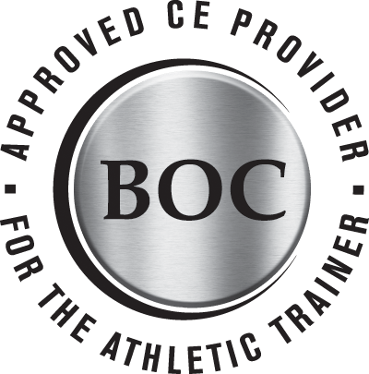
Physical Therapy/Athletic Training Credits:
The Office of Continuing Education is not responsible for awarding CEU/CE/Contact hours. You may obtain a letter of participation for hours of learning and submit it to your accrediting agency.
This symposium qualifies for 1 contact hour as recognized by New York State Education Department Board of Physical Therapy. For proof of attendance, please email patricia.lamb@stonybrookmedicine.edu
School of Health Technology and management, Stony Brook University (BOC AP #P3368) is approved by the Board of Certification, Inc. to provide continuing education to Athletic Trainers. This program is eligible for a maximum of 1 Category A CEU. AT’s should claim only those hours actually spent in the educational program. For proof of attendance, please email xristos.gaglias@stonybrook.edu with the completed pdf survey form for Athletic Trainers only, which was sent to your email with the Zoom meeting link on November 16. Certificates can take up to 14 days to receive.

Slide 7
Disclosures:
In compliance with the ACCME Standards for Commercial Support, everyone who is in a position to control the content of an educational activity provided by the School of Medicine is expected to disclose to the audience any relevant financial relationships with any commercial interest that relates to the content of his/her presentation.
George Greene, Barbara-Jean Ercolino, Dr. James Penna, Dr. Stuart Cherney, Dr. Brian Cruickshank, Dr. Kristin Hopkins, Dr. Meghan Paulus, Dr. Samantha Paulus, Dr. Diana Patterson, Dr. Anne Meo, the faculty, the planners, the reviewers, and the CME provider have no relevant financial relationship with a commercial interest (defined as any entity producing, marketing, re-selling, or distributing health care goods or services consumed by, or used on, patients), that relates to the content that will be discussed in the educational activity.

Slide 9
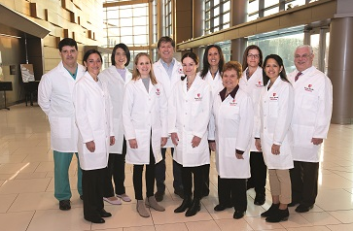
The Women’s Sports Medicine Center
The Women's Sports Medicine Center, the first of its kind in Suffolk County, is a division of the award-winning Department of Orthopaedics at Stony Brook University Hospital. The center focuses on treating and preventing sports-, performance- and exercise-related injuries among girls and women through a multidisciplinary approach utilizing the expertise of our mostly female staff of physicians, many of whom were athletes themselves.

Slide 10
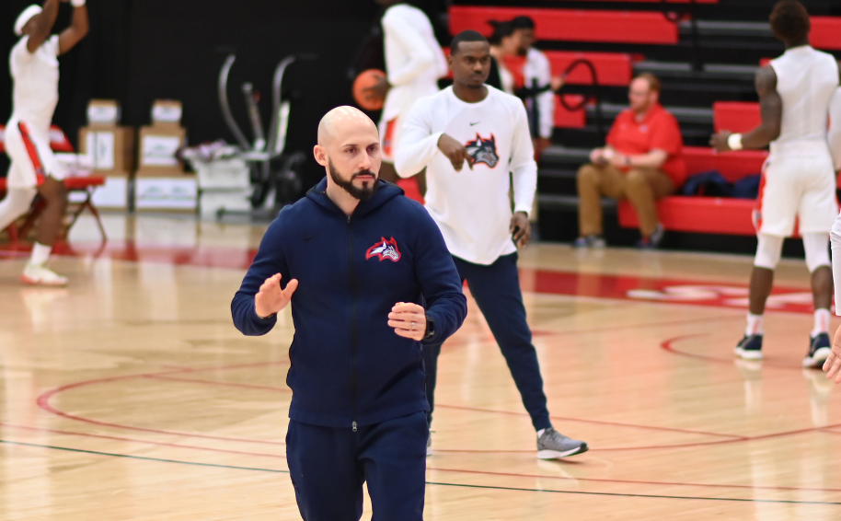
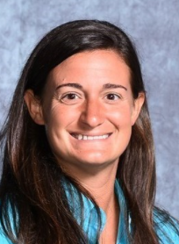
Presenters:
George Greene - Associate Athletic Director of High Performance and Competitive Success Stony Brook University Athletics
BJ Ercolino - Associate Athletic Trainer Stony Brook University Athletics

Slide 11
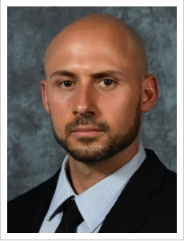
George Greene
George Greene serves as associate athletic director of high performance and competitive success with Stony Brook Athletics.
Greene oversees all aspects of athletic performance, performance nutrition and sports science. He also partners with coaches and administrators to identify opportunities to achieve sustained competitive success. He extensively works with the men’s basketball and football programs.
Greene is a graduate of Springfield College with a degree in applied exercise science. He holds a master’s degree through Fort Hays State University in health and human performance.
Greene is a certified strength and conditioning specialist (CSCS) and a registered strength and conditioning coach with distinction (RSCC*D) through the NSCA, a certified specialist in sports nutrition through the ISSA, a certified sports performance coach through USAW, a corrective exercise specialist (CES) through NASM, and is CPR/AED certified through the American Red Cross.

Slide 12
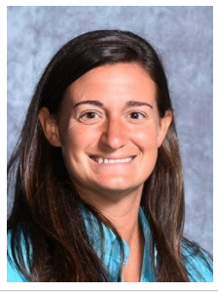
Barbara-Jean “BJ” Ercolino
Barbara-Jean "BJ" Ercolino began at Stony Brook as an assistant athletic trainer in September 2006. Ercolino earned her bachelor's degree in athletic training from High Point University in May 2003. She completed her master's degree in educational psychology and physical education at the University of Arizona in May 2005.
Ercolino serves as head athletic trainer for Stony Brook's football and women's lacrosse teams. She is responsible for the overall maintenance and operation of the athletic training room, including designing and implementing rehabilitation programs for injured student-athletes. Ercolino is also the primary insurance coordinator. In addition, she is an adjunct instructor and an approved clinical instructor in Stony Brook's Athletic Training Education Program (ATEP).

Slide 13
Questions
You can type your questions in the chat box at any time throughout this meeting. We will have time dedicated after the presentation to answer questions.
10th Annual Stony Brook Sports Medicine Update;
A Hands-On Approach to ACL Prevention in Female Athletes

Slide 14
The Women’s Sports Medicine Center
The Women's Sports Medicine Center, the first of its kind in Suffolk County, is a division of the award-winning Department of Orthopaedics at Stony Brook University Hospital. The center focuses on treating and preventing sports-, performance- and exercise-related injuries among girls and women through a multidisciplinary approach utilizing the expertise of our mostly female staff of physicians, many of whom were athletes themselves.

Slide 15
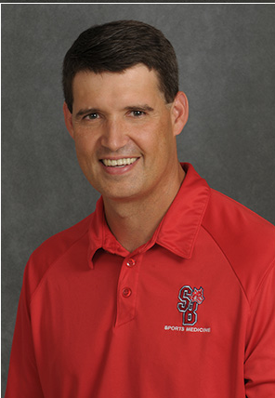
James Penna, MD
James Penna, MD is the Chief of our Sports Medicine Service and Team Physician for the Stony Brook University Seawolves Athletic Program. He has worked in the department of orthopaedics for over 20 years. He is the Vice Chair and Residency Program Director. Dr. Penna’s clinical practice focuses on the care of the injured athlete with emphasis on the Shoulder, Knee, and Elbow. He treats athletes of all ages from kids to seniors.
Education and Training
Medical School: SUNY @ Brooklyn/Downstate
Residency: SUNY @ Stony Brook, Orthopaedic Surgery
Residency: SUNY @ Stony Brook, Surgery
Fellowship: Northwell Health - Lenox Hill Hospital, Sports Medicine

Slide 16
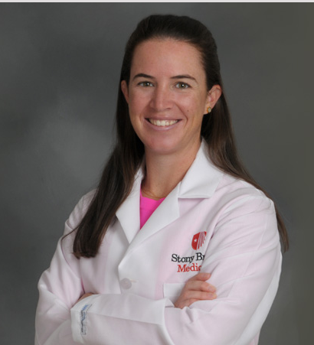
Kristin Hopkins, MD
Kristin T. Hopkins, M.D. is a fellowship trained orthopaedic surgeon specializing in sports medicine. She joined the Stony Brook team after completing her fellowship in Sports at Lenox Hill in Manhattan. Prior to that she did her residency at Montefiore Medical Center in the Bronx. Dr. Hopkins received her medical degree from SUNY Downstate and her undergraduate degree from Georgetown University, where she played Division 1 Field Hockey and was Dr. Paulus' teammate!
Dr. Hopkins is very excited to be heading the Women’s Sports Center and is really looking forward to being a part of this unique care team. Education and Training
Medical School: SUNY Downstate College of Medicine
Residency: Montefiore Medical Center, Albert Einstein COM, Orthopaedic Surgery
Fellowship: Northwell - Lenox Hill Hospital, Sports Medicine

Slide 17
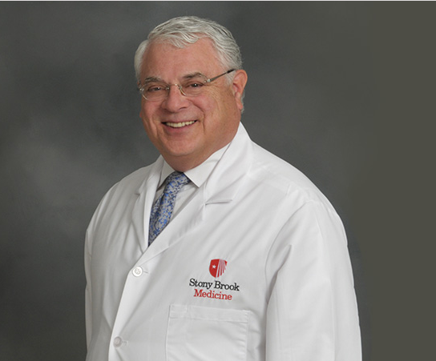
Stuart Cherney, MD
As one of the first sports medicine specialists on Long Island, Dr. Cherney has cared for high school, college, and professional athletes for over 30 years. At Stony Brook University he established the Sports Medicine Program and serves as head team physician for Stony Brook and St. Joseph's College. Dr. Cherney has focused his career on the prevention of sports-related injuries. He has spoken on the importance of having automated external defibrillators on the sidelines of sporting events and has presented ways to make athletic facilities safer for all participants. Education and Training
Medical School: Albany Medical College
Residency: Beth Israel Medical Center, Surgery
Residency: Mount Sinai Medical Center, Orthopaedic Surgery
Fellowship: Cincinnati Sports Medicine & Orthopaedic Ctr., Sports Medicine

Slide 18
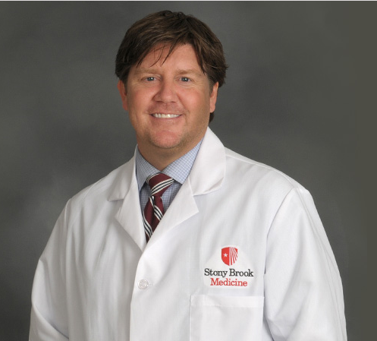
Brian Cruickshank, MD
Brian Cruickshank, MD is a Family Medicine Physician in the department of Orthopaedics specializing in non-surgical Sports Medicine, along with the evaluation and management of Sport Related Concussions. He serves as the Medical Director for the Stony Brook University Seawolves Athletic Program. His clinical practice focuses on
Education and Training
Medical School: St. George's University School of Medicine
Residency: University of Pittsburgh Medical Center, Family Medicine
Professional Other: Kaplan Medical,
Fellowship: University of Pittsburgh Medical Center, Sports Medicine

Slide 19
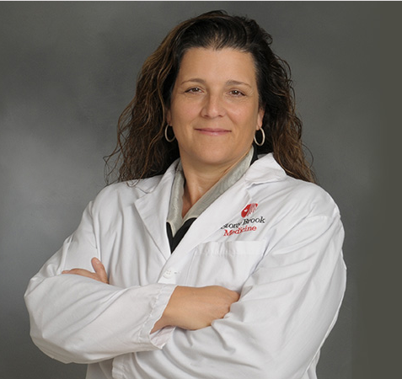
Anne Meo, DO
Anne Meo, DO is an orthopaedic surgeon with fellowship training in hand and wrist surgery. Dr. Meo treats all ailments of the hand and wrist including numb or locking fingers, traumatic crush injuries & fractures, soft tissue & bony masses, tendinopathies, and arthritis.
Education and Training
Medical School: NY College of Osteopathic Medicine
Residency: Peninsula Hospital Center, Orthopaedics
Internship: UMDNJ School of Osteopathic Medicine, Transitional Year
Fellowship: Stony Brook University Hospital, Hand Surgery

Slide 20
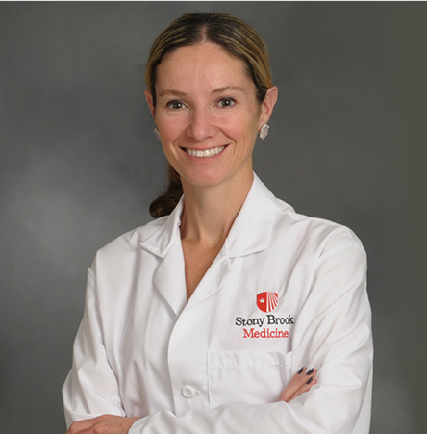
Samantha Muhlrad, MD
Samantha Muhlrad M.D. is a board-certified orthopaedic surgeon who is fellowship trained in hand surgery. She has a special interest in pediatric and sports medicine and has treated professional athletes, college athletes and high school athletes.
Education and Training
Medical School: Boston University
Residency: Stony Brook University Hospital, ORTHO
Residency: Stony Brook University Hospital, SURG
Fellowship: Stony Brook University Hospital, Hand Surgery

Slide 21
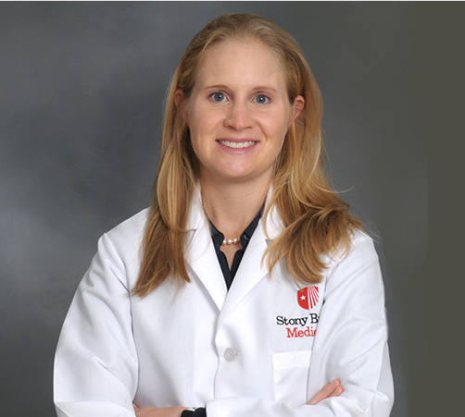
Diana Patterson, MD
Diana Patterson, MD is a board eligible orthopaedic surgeon. She treats patients with a broad range of sports and activity-related injuries to the knee, hip and shoulder.
Education and Training
Medical School: Icahn School of Medicine @ Mount Sinai
Residency: Icahn School of Medicine at Mount Sinai, Orthopaedic Surgery
Fellowship: Washington University Orthopaedics, Sports Medicine

Slide 22
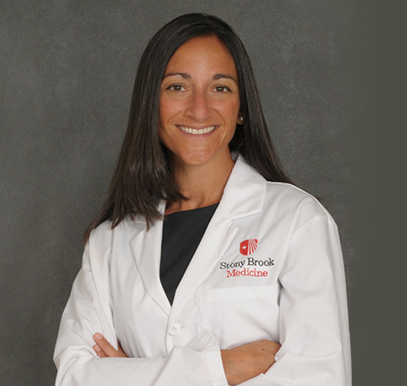
Megan Paulus, MD
Megan C. Paulus, MD is a fellowship trained orthopaedic foot and ankle surgeon. She has a special interest in treating ankle arthritis, fractures of the ankle and foot, post-traumatic reconstruction, midfoot and forefoot arthritis, flatfoot reconstruction, and bunions/hammertoes.
Education and Training Medical School: Georgetown University School of Medicine Residency: MedStar Georgetown University Hospital, Orthopaedic Surgery Internship: MedStar Georgetown University Hospital, Surgery Fellowship: Oakland Bone & Joints Specialists, Orthopaedic Foot & Ankle Surgery

Slide 23
Physician Assistants:
Jennifer Castelli
Robin Conversano
Jane Herfel
Michelle Regan
Maria Rojas

Slide 24
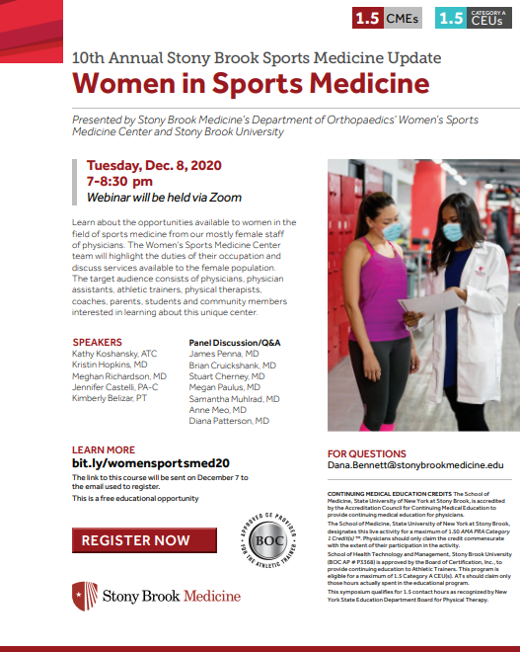
Register now for our next webinar:
Join us on December 8th at 7pm for the next webinar, “Women in Sports Medicine”, brought to you by the Stony Brook Department of Orthopaedics & the Women’s Sports Medicine Center. We will have speakers from multiple health care fields to help you better understand the ins and outs of their healthcare field.
Register at: bit.ly/womensportsmed20

Slide 25
Questions?
10th Annual Stony Brook Sports Medicine Update

Slide 26
Reminder for Physical Therapists/Athletic Trainers
For proof of attendance for Physical Therapists, please email patricia.lamb@stonybrookmedicine.edu
For proof of attendance for Athletic Trainers, please email xristos.gaglias@stonybrook.edu with the completed pdf survey form for Athletic Trainers only, which was sent to your email with the Zoom meeting link on November 16.
Each attendee of this webinar will be send a survey after the completion of this course by the Renaissance School of Medicine. Please complete this survey in a timely manner and leave comments so we can improve future webinars.
For additional questions or concerns, please contact Dana.Bennett@stonybrookmedicine.edu

Slide 28
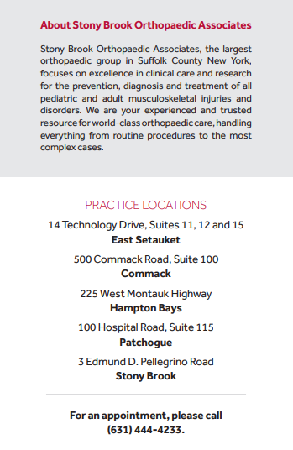

Slide 29
Thank you for attending this webinar.
For Orthopaedic Appointments with one of our physicians, Please call (631) 444-4233 to schedule.
Our next webinar, “Women in Sports Medicine”, will be held on December 8, 2020 @ 7pm via zoom. Registration is now open.
Register at: bit.ly/womensportsmed20
For additional questions or concerns, please contact Dana.Bennett@stonybrookmedicine.edu

