Slide 1
Deep Vein Thrombosis
Thrombus formation in Deep Veins of legs or thighs or Deep Veins of the Upper Extremities
Lower –tibial, soleal/gastrocnemius, peroneal, popliteal, femoral vein, deep femoral vein, common femoral vein, iliac veins, IVC.
Upper-SVC, IJ, Subclavian, Axillary, Brachial, Radial, Ulnar
Approximately 900,000 new cases diagnosed in the U.S. each year.
Notes:
Changed from 600,00- Slides from CDC- 900,00americans each year- Content source: http://www.cdc.gov/ncbddd/dvt/infographics/ha-vte/index.html

Slide 2
Deep Vein Thrombosis
15%
Death
Approximately one-third develop pulmonary embolism

Slide 3
VTE: Epidemiology
Untreated Proximal DVT
30-50% risk PE
12-15% mortality
Treated DVT
<8% risk PE
Mortality <2%
Notes:
This is important because untreated DVT has a significant risk of PE and mortality. In proximal DVT that risk is 30-50% for PE and 15% for mortality.

Slide 4
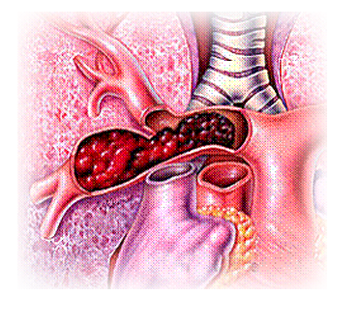
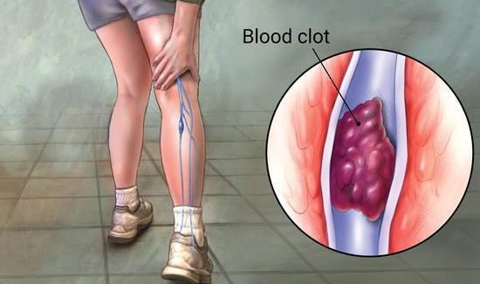
VTE: Epidemiology
Incidence - USA/Europe
DVT: 160 per 100,000
Symptomatic non-fatal PE: 20 per 100,000
Fatal PE: 50 per 100,000
Notes:
Incidence DVT is complicated by silent nature of most DVT’s, and nonspecific signs and symptoms. It depends on the population studied, the intensity of screening and accuracy of diagnostic test. Community based studies of venographic documented symptomatic DVT have reported a yearly incidence of 160 per 100,000.

Slide 5
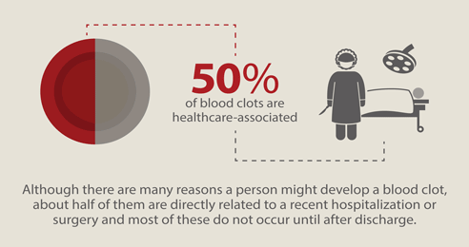
Hospital associated VTE
#1 cause of morbidity & mortality in hospitalized patients
10% of hospital deaths
Contributes to 15% of hospital deaths
Content source: http://www.cdc.gov/ncbddd/dvt/infographics/ha-vte/index.html
Spyropoulos AC and Lin J. Direct medical costs of venous thromboembolism and subsequent hospital readmission rates: an administrative claims analysis from 30 managed care organizations. Journal of Managed Care Pharmacy 2007;13:475-486.
Notes:
Related to healthcare- inpatient and outpatient

Slide 6
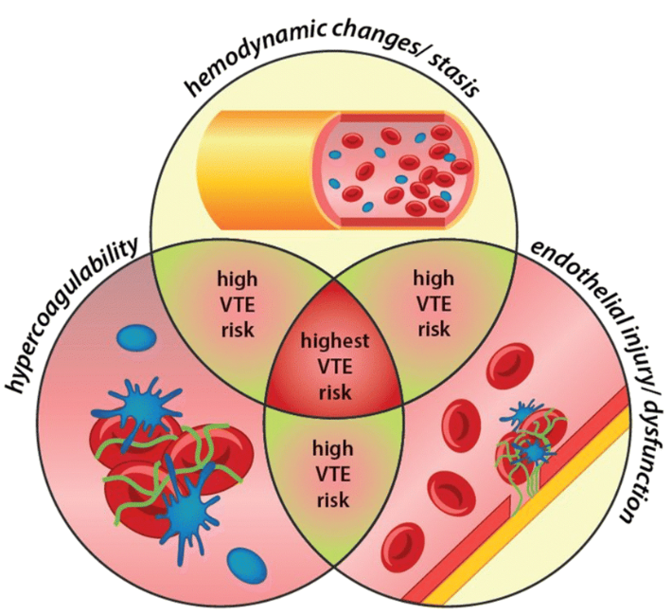
VTE: Pathophysiology
Virchow’s Triad
Alterations in blood flow - Venous Stasis
Alterations in blood constituents-hypercoagulability
Vascular endothelium damage
Notes:
Virchow’s triad of factors that predispose to VTE are venous stasis, hypercoagulability, and endothelium damage; these are as true today as when postulated in the 19th century. It is often necessary for at least two of these factors to coexist for VTE to occur.

Slide 7
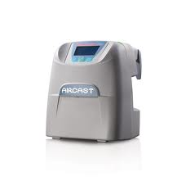
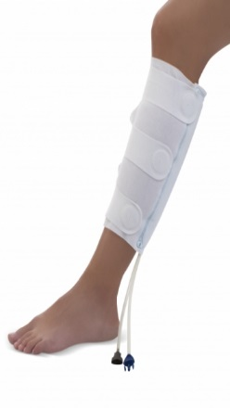
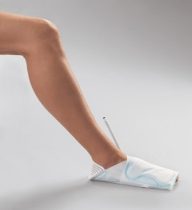
Benefit of compression therapy (SCD)
Mechanical compression imitates the effect of walking
The mechanical action of SCD’s affects all 3 aspects of Virchow's triad:
Increases velocity of venous return, creating turbulence to prevent blood Stasis/Clotting
Decreases hypercoagulability by increasing fibrinolytic activity through stimulation caused by the intermittent pneumatic compression
Inhibition of vasodilation may reduce endothelial damage
SCD’s should be worn while in bed and sitting in the chair, but removed for walking.
FLOW
BLOOD
VESSEL
WE HAVE BOTH-CALF AND FOOT

Slide 8
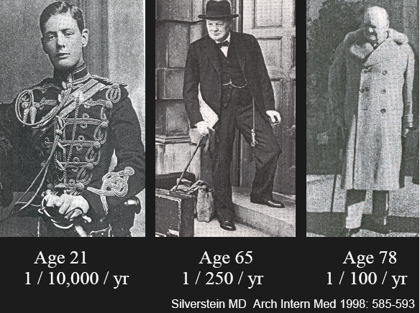
VTE: Predisposing Factors
Principal Risk Factors
Immobilization
Trauma
Surgery
Infection [Covid-19]
Post-partum period
Indwelling venous access devices/pacemakers
Other Factors
Age
Obesity
Malignancy
Previous VTE
Varicose Veins
Dehydration
Hormonal Therapy
Aggressive AC reversal
Notes:
Immobilization is associated with stasis and development of DVT. The prevalence of DVT is associated with the length of time of immobilization.
Advancing Age is also associated with increasing incidence of DVT through several factor. Advanced age is associated with increasing thrombotic state and increasing stasis in the soleal veins. Risk doubles with each decade >50y.
25% of all acute DVT patients have a previous episode of DVT. Malignancy is present in 20-30% of all DVT pattients.and approx. 15% of malignancies are complicated be DVT.

Slide 9
Covid-19 and VTE
Covid-19 infection increases the risk of venous and arterial thromboembolism.
This significant increase in risk is not included in current VTE risk assessment tools, but planned for future Caprini Risk Score
Escalation of anticoagulation for patients at highest risk for VTE; critically ill, obese, or with high levels of D-dimer has been implemented
Critically ill patients were shown to have positive outcomes, but high quality evidence is lacking-There are numerous ongoing clinical trials
VTE pharmacologic prophylaxis unless contraindication, then mechanical
Consider both pharmacologic and mechanical VTE prophylaxis (SCD) if no contraindication to either modality when high risk
Consider post-hospital prophylaxis for patients with high VTE risk and low bleeding risk
Notes:
DVT/PE, MI, Cerebral infarction, splenic, mesenteric infarction Microthrombosis –lungs, kidneys, other organs. In situ thrombus
Coag cascade not the only pathway
Endothelial and platelet activation
Inflammation-plt activation Autoimmune Phenomena

Slide 10
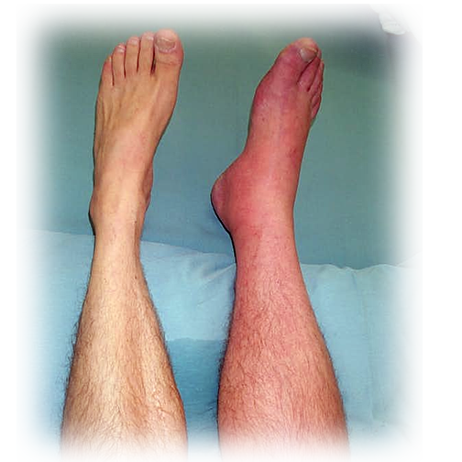
VTE: Signs & Symptoms
DVT
Asymptomatic
Pain/tenderness
Erythema
Acute swelling
Pallor- Phlegmasia Alba
Cyanosis- Phlegmasia Cerulea
PE
Dyspnea & Tachypnea
Syncope
Diaphoresis
Hemoptysis
Low-grade fever
Pleuritic CP
Cough
Hypotension
CXR
EKG

Slide 11
VTE: Diagnosis
Venography – ex-gold standard
Duplex Ultrasound
Comfortable
Inexpensive
No risk
Good sensitivity and specificity for distal
Less sensitive for proximal DVT
Notes:
CTV and MRV – excellent senstivity for proximal DVT (pelvic and caval thrombosis
Venography – gold standard but infrequently used b/c of disadvantages.
Duplex is the current mainstay of the diagnosis of DVT.

Slide 12
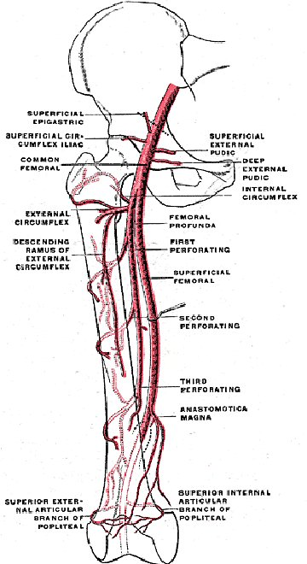
Arteries and Veins

Slide 13
Correct nomenclature
The term “superficial femoral vein “
should never be used, because the femoral vein is in fact a deep vein and is not part of the superficial venous system.
Confusion arising from use of the inappropriate name has been responsible for many cases of clinical mismanagement and death
Management of “superficial femoral vein” thrombosis should be the same as any DVT

Slide 14
The Superficial Femoral Vein A Potentially Lethal Misnomer Warner P. Bundens, MD; John J. Bergan, MD; Nicholas A. Halasz, MD; Jay Murray, MD; Margaret Drehobl, MD. JAMA. 1995;274:1296-1298
A total of 46 family practitioners and general internists, 95 anatomists, and 85 laboratory directors.
Only 24% (11/46) of the respondents would have administered anticoagulants to the patient as described
Big patient safety concern!

Slide 15
The Superficial Femoral Vein A Potentially Lethal Misnomer Warner P. Bundens, MD; John J. Bergan, MD; Nicholas A. Halasz, MD; Jay Murray, MD; Margaret Drehobl, MD. JAMA. 1995;274:1296-1298
Only 3% (3/95) of anatomists felt the term "superficial femoral vein" was correct, 22% (21/95) felt it was an acceptable alternative, and only 7% (7/95) of anatomists felt the term was preferred for everyday use
The term "superficial femoral vein" is used by 93% (79/85) of vascular laboratories in lower limb venous duplex reports.

Slide 17
VTE Prevention
◻Most hospitalized patients have a Moderate to High Risk for VTE
Prophylaxis decreases the incidence of VTE
Systematic risk assessment (VTE Advisor)and prophylaxis programs improve prophylaxis rates
Prophylaxis includes Pharmacological and Mechanical options
Requirement CMS/UHC/JC/NSQIP
Are 100% of your patients receiving adequate VTE prophylaxis 100% of the time?

Slide 18
Screening/Acute proximal DVT
◻Consider DUS screening to R/O DVT present on admission for patients with a High VTE Risk and:
Transfer from another institution
Found “down” for prolonged amount of time
Prolonged immobilization for extrication
◻Consider vascular consult for acute Iliofemoral DVT with significant swelling/pain

Slide 19
Benefit of compression therapy (SCD)
Mechanical compression imitates the effect of walking
The mechanical action of SCD’s affects all 3 aspects of Virchow's triad:
Increases velocity of venous return, creating turbulence to prevent blood Stasis/Clotting
Decreases hypercoagulability by increasing fibrinolytic activity through stimulation caused by the intermittent pneumatic compression
Inhibition of vasodilation may reduce endothelial damage
SCD’s should be worn while in bed and sitting in the chair, but removed for walking.
FLOW
BLOOD
VESSEL
WE HAVE BOTH-CALF AND FOOT

