Slide 1
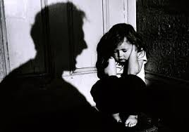
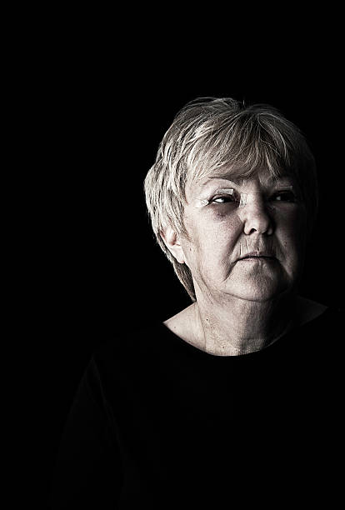

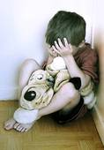



Family Violence (Child Abuse, Domestic Violence, Elder Abuse)
Prepared by Susan McCarthy, LCSW, MS Public Health, CCM
Director of Social Work Services, Stony Brook University Hospital
Family Violence 4/2023

Slide 2


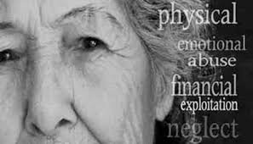
Family Violence
Family Violence Includes:
Child Abuse, Neglect and Maltreatment
Domestic Violence/Intimate Partner Violence
Elder Abuse
Family Violence

Slide 3
Power Point Slide Index
Slide 4 Policies and Procedures
Slides 5 – 27 Child Abuse, Neglect and Maltreatment
Slides 28 – 55 Domestic Violence
Slides 56 – 64 Elder Abuse
Slide 65 Contacts & Resources
Slide Index

Slide 4
Stony Brook Medicine Policies & Procedures
PC0003: Identification and Treatment of Family Violence, Abuse, Neglect, and Maltreatment
PC0162: Identification and Response to Child Abuse, Neglect and Maltreatment
P520: Domestic Violence and the Workplace Policy
  SBUH staff members identify, assess, treat, and/or refer to community agencies all patients who are confirmed or alleged victims of abuse, neglect and or maltreatment.
SBUH Policies and Procedures

Slide 5


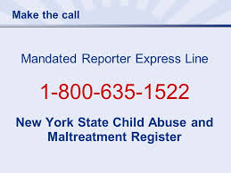



Child Abuse, Neglect, and Maltreatment
Child Abuse, Neglect, and Maltreatment

Slide 6
Child Abuse: Definitions of Child Abuse, Neglect & Maltreatment
New York State Office of Children & Family Services Definition of Child Abuse: An "abused child" is a child whose parent or other legally responsible for his/her care inflicts upon the child:
    serious physical injury,
    creates a substantial risk of serious physical injury, or
    commits an act of sex abuse against the child.
“Other legally responsible” person refers to a guardian or caretaker age 18 or over.
A person can be abusive to a child if they:
    perpetrate any of the above actions against a child in their care, or
    if they allow someone else to do these things to that child.
Definition of Maltreatment and Neglect: A child’s physical, mental or emotional condition has been impaired, or placed in imminent danger of impairment, by the failure of the child's parent or other person legally responsible to exercise a minimum degree of care by failing to provide:
Food * Clothing *Shelter *Education * Medical Care when they are FINANCIALLY ABLE to do so.
Child Abuse, Neglect, and Maltreatment
Notes:
The term abuse encompasses the most serious of harms committed against children.

Slide 7

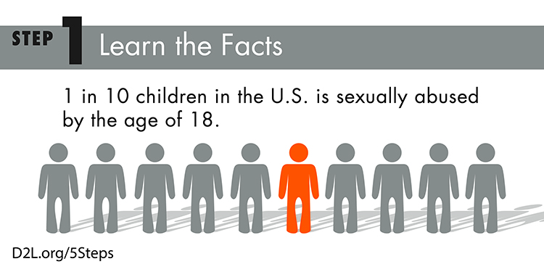
National Child Abuse Statistics
A report of suspected child abuse is made in the US every 10 seconds.
Almost five children die every day as a result of child abuse.
Approximately 3.5 million reports of child abuse are made every year in the U.S.
As many as one in three girls and one in seven boys will be sexually abused before their 18th birthday.
Child Abuse occurs at every socioeconomic level, across ethnic, cultural, and religious lines.
Child Abuse, Neglect, and Maltreatment

Slide 8

The Biggest Myth About Child Abuse
Child Abuse, Neglect, and Maltreatment

Slide 9
Suspected Cases of Child Abuse at SBUH
Stony Brook Medicine *cases that were called in and accepted for suspected child abuse or maltreatment to the New York State Central Registry (SCR).
2013: 445 Cases
2014: 557 Cases
2015: 484 Cases
2016: 551 Cases
2017: 724 Cases
2018: 634 Cases
2019: 524 Cases
2020: 597 Cases
2021: 557 Cases
2022: 465 Cases
* Number of Cases does not include number of children
Child Abuse, Neglect, and Maltreatment

Slide 10
Child Protective Services (CPS) Data Report
By Suspicion Codes 2019-2022
Suspicion of Child Abuse | Code | 2019 | % | 2020 | % | 2021 | % | 2022 | % | Total # Cases
Inadequate Guardianship | IA | 271 | 29% | 314 | 32% | 285 | 35% | 231 | 33% | 1101
Parent's Drug/Alcohol misuse | PDA | 163 | 17% | 168 | 17% | 130 | 16% | 109 | 16% | 570
Other | OTHER | 88 | 9% | 76 | 8% | 33 | 4% | 53 | 8% | 250
Lack of Supervision | LS | 63 | 7% | 76 | 8% | 60 | 7% | 50 | 7% | 249
Lack of Medical Care | LMC | 47 | 5% | 46 | 5% | 64 | 8% | 58 | 8% | 215
Laceration, Bruises, Welts | LBW | 37 | 4% | 42 | 4% | 46 | 6% | 28 | 4% | 153
Excessive Corporal Punishment | ECP | 39 | 4% | 33 | 3% | 47 | 6% | 34 | 5% | 153
New Toxicology Positive For Infants | TPI | 77 | 8% | 57 | 6% | 17 | 2% | 0 | 0% | 151
Sexual Abuse | SA | 30 | 3% | 28 | 3% | 27 | 3% | 17 | 2% | 102
Child's Drug/Alcohol Abuse | CDAA | 20 | 2% | 28 | 3% | 19 | 2% | 32 | 5% | 99
Fractures | FRA | 16 | 2% | 26 | 3% | 15 | 2% | 8 | 1% | 65
Emotional Neglect | EMN | 18 | 2% | 14 | 1% | 14 | 2% | 13 | 2% | 59
Choking/Shaking/Twisting | CHK | 10 | 1% | 15 | 2% | 16 | 2% | 10 | 1% | 51
Burns/Scalding | BUSC | 10 | 1% | 12 | 1% | 14 | 2% | 8 | 1% | 44
Inadequate Food and Shelter | IFS | 16 | 2% | 11 | 1% | 0 | 0% | 13 | 2% | 40
Educational Neglect | EDN | 5 | 1% | 10 | 1% | 10 | 1% | 6 | 1% | 31
Internal Injuries (e.g. Subdural Hematoma) | INJ | 9 | 1% | 5 | 1% | 6 | 1% | 9 | 1% | 29
Abandonment | ABD | 8 | 1% | 10 | 1% | 3 | 0% | 3 | 0% | 24
Swelling/Dislocation/Sprains | SDS | 5 | 1% | 3 | 0% | 6 | 1% | 5 | 1% | 19
DOA/Fatality | DOA | 0 | 0% | 3 | 0% | 5 | 1% | 5 | 1% | 13
Malnutrition/Failure to Thrive | MAL | 2 | 0% | 1 | 0% | 3 | 0% | 2 | 0% | 8
Poisoning/noxious Substances | CSA | 0 | 0% | 2 | 0% | 1 | 0% | 4 | 1% | 7
Inappropriate Custodial Conduct(Institutional Abuse Only) | ICC | 1 | 0% | 3 | 0% | 0 | 0% | 0 | 0% | 4
Inappropriate Isolation/Restraining | IRR | 0 | 0% | 0 | 0% | 0 | 0% | 0 | 0% | 0
•Total number represents multi-level field. | Total | 935 | 100% | 983 | 100% | 821 | 100% | 698 | 100% | 3437
Child Abuse, Neglect, and Maltreatment

Slide 11
Top 5 Suspicious CPS Codes
Reported by SBUH
Child Abuse, Neglect, and Maltreatment

Slide 12
CPS Positive Toxicology Cases 2017-2020 CPS Data
Positive Toxicology Cases Reported to CPS for 2019-2022 | 2019 | % | 2020 | % | 2021 | % | 2022 | % | Total # Cases
05NN | 37 | 42% | 17 | 30% | 14 | 82% | 0 | n/a | 68
06EP | 22 | 25% | 17 | 30% | 2 | 12% | 0 | n/a | 41
06EN | 24 | 27% | 14 | 25% | 0 | 0% | 0 | n/a | 38
05EP | 4 | 4% | 1 | 2% | 0 | 0% | 0 | n/a | 5
04PD | 0 | 0% | 4 | 7% | 0 | 0% | 0 | n/a | 4
05EA | 1 | 1% | 0 | 0% | 1 | 6% | 0 | n/a | 2
CPEP | 0 | 0% | 1 | 2% | 0 | 0% | 0 | n/a | 1
05OB | 1 | 1% | 0 | 0% | 0 | 0% | 0 | n/a | 1
06W1 | 0 | 0% | 1 | 2% | 0 | 0% | 0 | n/a | 1
MRN | 0 | 0% | 1 | 2% | 0 | 0% | 0 | n/a | 1
OUTPATIENT | 0 | 0% | 1 | 2% | 0 | 0% | 0 | n/a | 1
11N | 0 | 0% | 0 | 0% | 0 | 0% | 0 | n/a | 0
15S | 0 | 0% | 0 | 0% | 0 | 0% | 0 | n/a | 0
Total | 89 | 100% | 57 | 100% | 17 | 100% | 0 | n/a | 163
Child Abuse, Neglect, and Maltreatment

Slide 13
CPS Data by Location
2019-2022
Location | 2019 | % | 2020 | % | 2021 | % | 2022 | % | Total # Cases
CPEP | 173 | 33% | 165 | 28% | 138 | 25% | 177 | 38% | 653
04PD | 101 | 19% | 152 | 25% | 181 | 32% | 81 | 17% | 515
06EA, 06EN & 06EP | 60 | 11% | 74 | 12% | 42 | 8% | 45 | 10% | 221
06W1, 06W2, 06W3 | 44 | 8% | 42 | 7% | 41 | 7% | 54 | 12% | 181
05NN | 50 | 10% | 46 | 8% | 46 | 8% | 24 | 5% | 166
04PT | 32 | 6% | 30 | 5% | 21 | 4% | 17 | 4% | 100
Outpatient Clinics & Cancer Center | 17 | 3% | 21 | 4% | 16 | 3% | 15 | 3% | 69
10N & 12N | 16 | 3% | 9 | 2% | 20 | 4% | 10 | 2% | 55
05EP , 05EN, 05EA, 05OB | 10 | 2% | 19 | 3% | 22 | 4% | 4 | 1% | 55
07W3 | 0 | 0% | 8 | 1% | 9 | 2% | 16 | 3% | 33
15 N & 15 S | 1 | 0% | 10 | 2% | 6 | 1% | 5 | 1% | 22
08BN | 5 | 1% | 3 | 1% | 4 | 1% | 4 | 1% | 16
17S, 17N, 18N, 18S, 19N, 19S | 6 | 1% | 2 | 0% | 3 | 1% | 3 | 1% | 14
12S & 9N | 4 | 1% | 1 | 0% | 2 | 0% | 2 | 0% | 9
MRN | 1 | 0% | 3 | 0% | 2 | 0% | 3 | 1% | 9
11N & 11S | 0 | 0% | 4 | 1% | 2 | 0% | 0 | 0% | 6
16 N & 16 S | 1 | 0% | 1 | 0% | 1 | 0% | 3 | 1% | 6
14S | 2 | 0% | 1 | 0% | 1 | 0% | 0 | 0% | 4
05SD & 05CC | 1 | 0% | 2 | 0% | 0 | 0% | 0 | 0% | 3
09W2 | 0 | 0% | 2 | 0% | 0 | 0% | 1 | 0% | 3
08W1 & 8W3 | 0 | 0% | 2 | 0% | 0 | 0% | 0 | 0% | 2
9S | 0 | 0% | 0 | 0% | 0 | 0% | 1 | 0% | 1
Total | 524 | 100% | 597 | 100% | 557 | 100% | 465 | 100% | 2143
Child Abuse, Neglect, and Maltreatment

Slide 14

Who is a Mandated Reporter?
Mandated Reporters
All hospital personnel engaged in the admission, examination, care or treatment of patients including but not limited to:
Physician/PA
Nurse/NP
Social Worker
Therapist
Dentist
X-Ray/LabTech
EMT
Mandated reporters are those individuals who must report suspected child abuse or maltreatment.
Mandated reporters are only mandated to make a report, or cause a report to be made, when they have reasonable cause to suspect that a child coming before them in their professional or official capacity is abused or maltreated.
Child Abuse, Neglect, and Maltreatment

Slide 15

What Is a Professional Role or Capacity?
A nurse admitting a child in her practice who has a reasonable suspicion of abuse must report her concern.
In contrast, the nurse who witnesses child abuse when riding her bike while off-duty is not mandated to report that abuse.
Anyone may report any suspected abuse at any time and is encouraged to do so.
Mandated reporters who are social services workers have expanded reporting requirements.
Social services workers are required to report when, in their official or professional role, they are presented a case by any person (mandated reporter or non-mandated reporter) which appears to be a suspected case of child abuse based on reasonable cause.
Child Abuse, Neglect, and Maltreatment

Slide 16
When Do I Report?
Reporting
Under current law, if a mandated reporter has reasonable cause to suspect that a child coming before him or her in his or her professional/official capacity is an abused or maltreated child, he or she must immediately report such suspicion to the Statewide Central Register of Child Abuse and Maltreatment. (SSL §§413, 415)
Based on your rational observations, professional training, and experience, you have a suspicion that the parent or other person legally responsible for a child is responsible for harming that child or placing that child in imminent danger of harm.
Your suspicion can be as simple as distrusting an explanation for an injury or a story suddenly changing.
Legal Considerations
New York State Social Services Law provides confidentiality for mandated reporters.
Reporters who have reasonable cause to suspect and make a report in good faith are immune from criminal and civil liability that may result from the report.
Willful failure to report may result in Class A Misdemeanor charges and civil liability.
What is Reasonable Cause?
Child Abuse, Neglect, and Maltreatment

Slide 17
How Can I Be Sure?
Many Cases are Not Clear; recent cases:
Baby fell out of mother’s arms while she was feeding him in the hospital. The baby fractured his skull.
Thirteen year old left alone started fire and was badly burned when cooking macaroni and cheese.
Older Child with ongoing behavioral issues tried to hurt younger sibling by smothering him with a pillow. Mother appropriately concerned and brought older child to hospital for evaluation.
Child lives with mother who is an admitted drug addict and a father who does not drink or use drugs.
Fifteen year old child delivers child. Grandparents unaware of pregnancy.
Mother is on methadone maintenance and baby was born withdrawing.
Parents opposed to recommended medical intervention.
Fractured skull 2 years old after falling off couch which was witnessed .
NONE of these were accepted by NYS Central Registry
Child Abuse, Neglect, and Maltreatment

Slide 18
Mandated Reporter Obligation
It is safer to make the call.
Section 420. Penalties for Failure to Report.
Any person, official, or institution required by this title to report a case of suspected child abuse or maltreatment who willfully fails to do so shall be guilty of a class A misdemeanor.
Calls are made to the New York State Central Registry (SCR)
Mandated: 1-800-635-1522
Non-Mandated: 1-800-342-3720
The SCR Hotline Number is open 24-hours a day, seven days a week.
Calls should be made AS SOON AS you suspect a child has been a victim of child abuse, maltreatment or neglect.
https://www.suffolkcountyny.gov/Departments/Social-Services/Child-Support-Enforcement-Bureau/Reporting-Child-Abuse
Child Abuse, Neglect, and Maltreatment

Slide 19
Making The Report to NYSCR
The following information must be provided to the child abuse specialist when making the telephone report to the NYSCR (New York State Central Registry):
  Name, title of caller, and name of institution
  Reporters concerns about all suspected abuse or maltreatment of the child(ren)
  Child and caregiver’s demographic information
  Hospital plan of care and probable disposition of the child
The following information must be obtained from the Registry when the report is accepted by the SCR and documented in the patient’s chart:
  Name of the person to whom the report was made
  Registry Call ID Number assigned to the case
  Official call time provided by the Registry
This information will be put in the patients chart and on the New York State Child Abuse Form.
Child Abuse, Neglect, and Maltreatment

Slide 20

What If A Child Is In Imminent Danger?
911 should be called if a child is deemed to be in imminent danger.
A hospital administrator, or Attending Physician can take all measures necessary to protect the child including, where appropriate, retaining custody of a child.
A call to SCR should be made concurrently with administrative decisions regarding the child’s welfare.
Child Abuse, Neglect, and Maltreatment

Slide 21
The Role of Social Work
When it is reasonably believed that a child is being abused or maltreated, a Social Worker should be called immediately to assist with patient/family and assess.
Call Social Work Services (4-2552) during normal work hours. After normal working hours page the On-Call Social Worker through the hospital operator.
Social Workers cover the ED from 8 AM to 12 midnight on weekdays and from 10 AM to 8 PM on weekends. On-Call Social Work available 24/7.
The Social Worker will assist you in fulfilling your responsibilities as a mandated reporter.
Inability to reach a Social Worker should not impact your obligation to fulfill your duties as a mandated reporter.
Child Abuse, Neglect, and Maltreatment

Slide 22
Possible Indicators of Physical Abuse
Possible Indicators of Physical Abuse
Metaphyseal Fractures, long bone fractures in non ambulating children.
Most Head Traumas especially in infants or young children without plausible explanation.
Most burns including emersion burns.
Injuries to the eyes or head;
Bi-lateral body (accidental injuries typically only affect one side of the body);
Injuries that do not match the child’s developmental capability;
Frequent injuries of any kind (bruises, cuts, and/or burns);
Injuries where the history cannot explain the injury or a serious injury is not witnessed;
Distinctive patterns such as grab marks, human bite marks, cigarette burns, or impressions of other instruments.
Child Abuse, Neglect, and Maltreatment

Slide 23
Possible Indicators of Maltreatment or Neglect
Indicators of Maltreatment or Neglect
Obvious malnourishment or inability to provide food;
Lack of personal care - poor personal hygiene, torn and/or dirty clothes;
Untreated need for glasses, dental care, or other medical attention;
Frequent absence from or tardiness to school;
Child inappropriately left unattended or without supervision;
Parents/guardian under influence of drugs/alcohol.
Child Abuse, Neglect, and Maltreatment

Slide 24
Possible Indicators of Sexual Abuse
Possible Indicators of Sexual Abuse
& Behavior Indicators of Abuse
Symptoms of sexually transmitted diseases;
Injury to genital area;
Difficulty and/or pain when sitting or walking;
Sexually suggestive, inappropriate or promiscuous behavior or verbalization;
Expressing age-inappropriate knowledge of sexual relations; and
Sexual victimization of other children.
Behavioral Indicators of Abuse
Destructive, aggressive, or disruptive behavior;
Passive, withdrawn, or emotionless behavior;
Fear of going home;
Fear of a parent;
Increased anxiety or depression;
Child’s admission that he/she is being hurt, neglected or
Significant changes in sleeping, toileting, eating patterns.
Child Abuse, Neglect, and Maltreatment

Slide 25
NEW YORK STATE
OFFICE OF CHILDREN AND FAMILY SERVICES
REPORT OF SUSPECTED
CHILD ABUSE OR MALTREATMENT
To access a copy of this form LDSS-2221A:
via Internet: http://www.ocfs.state.ny.us/main/forms/cps/
via Intranet: http://ocfs.state.nyenet/admin/forms/SCR/
This form is also available
online via the Resources Tab on “The Pulse”
Go to Resources on Top Click drop down arrow.
Go to clinical and professional Resources A-Z
Go to Child Abuse( recognizing and reporting)
Information, contact info, and forms available
Child Abuse, Neglect, and Maltreatment

Slide 26
Submit the written paper copy of the LDSS-2221A form originally signed to the County Department of Social Services (DSS) where the abused/maltreated child resides.
To locate your local DSS visit http://www.ocfs.state.ny.us/main/localdss.asp
Child Abuse, Neglect, and Maltreatment

Slide 27
Documentation
If the case is accepted by the SCR, Form L-DSS-2221-A “Report of Suspected Child Abuse or Maltreatment” must be completed by the mandated reporter.
The form must include all the information given to the SCR when the call was made.
The completed form must be delivered to the hospital Child Protection Coordinator in the Social Work Office, located in the Hospital on Level 1 Room 793, within 24 hours of the initial telephone report, or the morning of the next work day.
Document your concerns and the outcome of the call to the SCR in the patient’s chart and notify the treatment team of the status.
Child Abuse, Neglect, and Maltreatment

Slide 28



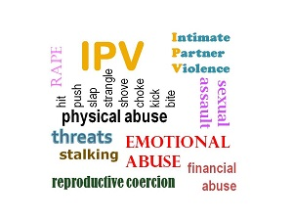
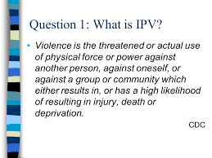
Domestic Violence
Domestic Violence

Slide 29
Domestic Violence Overview
Domestic Violence historically was referred to as Spousal Abuse. It is no longer referred to as “Spousal Abuse” due to the fact that the violence crosses into non-married and same gender couples. Intimate Partner Violence( IPV) is the most recent phrase or acronym for this important and serious issue.
It is defined as pattern of abusive behaviors by one or both partners in an intimate relationship such as marriage, dating, family, friends, or cohabitation that is used by one partner to gain or maintain power and control over another intimate partner.
Domestic violence can happen to anyone regardless of race, age, sexual orientation, religion, or gender.
Domestic violence is a serious, preventable public health problem affecting more than 32 million Americans or over 10% of the U.S. population.
One in every four women and one in every seven men will experience domestic violence in her lifetime.
Of all the woman murdered every year, 1/3 are killed by an intimate partner.
Domestic Violence Overview
Domestic Violence

Slide 30
Domestic Violence Overview
Alcohol and drug abuse, addiction, and mental illness can be co-morbid with domestic violence, and present additional challenges when present alongside patterns of abuse.
On a typical day there are more than 20,000 phone calls placed to domestic violence hotlines nationwide.
The presence of a gun in a domestic violence situation increases the risk of homicide by 500%.
Intimate partner violence accounts for 15% of all violent crime.
Women between the ages of 18-24 are most commonly abused by an intimate partner; only 34% of people who are injured by intimate partners receive medical care for their injuries.
19% of domestic violence involves a weapon.
Domestic victimization is correlated with a higher rate of depression and suicidal behavior.
Domestic Violence Overview
Domestic Violence

Slide 31
Domestic Violence Statistics
An average of 24 people per minute are victims of rape, physical violence or stalking by an intimate partner in the US ( more then 12 million woman and men over the course of a single year)
1 in 4 woman and 1 in 7 men age 18 and older in the US have been the victim of severe violence by an intimate partner in their lifetime.
Almost half of all women and men in the US have experienced psychological aggression by an intimate partner in their lifetime.
Woman ages 18-24 and 25-34 generally experience the highest rates of intimate partner violence.
Nearly 1 in 10 woman in the US have been raped by an intimate partner in their lifetime.
Children witnessed violence in nearly 1 in 4 intimate partner violence cases
30%-60% of intimate partner violence perpetrators also abuse children in the household
Domestic Violence

Slide 32
Domestic Violence –
Examples of Physical Abuse
Causing Physical Pain in any way
Hitting, punching, pinching, kicking with body or other object
Throwing
Pulling hair
Use of a dangerous weapon or deadly weapon including objects not normally used as a weapon;
Throwing objects
Burning
Holding or twisting arms/legs/other parts of body
Holding back doors or blocking free movement
Holding person down to trap or hurt
Domestic Violence

Slide 33
Domestic Violence –
Examples of Sexual Abuse
Any non-consensual sexual contact
Forcing a sexual activity
Forcing unwanted sexual behaviors or activities
Threatening behaviors
Derogatory Name Calling
Refusal to use contraception
Deliberately causing unwanted physical pain during sex,
Deliberately passing on sexual diseases or infections
Using objects, toys, or other items without consent
Domestic Violence

Slide 34
Domestic Violence –
Examples of Financial Abuse
Controlling how all of the money is spent
Not allowing the victim access to bank accounts
Withholding money or giving “an allowance”
Forbidding the victim from attending job training or advancement opportunities
Forcing the victim to write bad checks or file fraudulent tax returns
Running up large amounts of debt on joint accounts, taking bad credit or loans
Hiding assets
Stealing the victim’s identity, property or inheritance
Refusing to pay bills and ruining the victims’ credit score
Refusing to pay or evading child support or manipulating the divorce process by drawing it out by hiding or not disclosing assets
Domestic Violence

Slide 35
Domestic Violence – Examples of
Psychological or Emotional Abuse
Humiliating the victim in public or private
Demeaning the victim in public or private
Controlling what the individual can and cannot do
Withholding information from the individual
Deliberately doing something to make the individual feel diminished or embarrassed
Isolation the Victim from friends and/or family
Convincing the victim that they are “crazy”
Purposely causing undo stress to the victim
Blaming the victim consistently for issues or problems in the relationship
Making unreasonable demands
Criticizing for incomplete task
Demanding
Cruel
Stalking
Domestic Violence

Slide 36
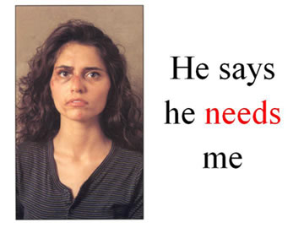
Why do people stay
in abusive relationships?
The victim:
      fears the abusers violent behavior and will escalate if they try to leave
      loves his/her abuser and believes (s)he will change
      believes abuse is a normal part of a relationship
      is financially dependent on the abuser
      wants her/his children to have two parents.
      religious and/or cultural beliefs preclude him/her from leaving
      has low self esteem and believe he is to blame for the abuse
      is embarrassed to let others know he has been abused
      has nowhere to go if he leaves
      fears retribution from the abusers friends or family
Domestic Violence

Slide 37
Why Won’t They Leave?
People who have never been abused often wonder why a person wouldn’t just leave an abusive relationship. They don’t understand that leaving can be more complicated than it seems.
Leaving is often the most dangerous time for a victim of abuse, because abuse is about power and control. When a victim leaves, they are taking control and threatening the abusive partner’s power, which could cause the abusive partner to retaliate in very destructive ways.
Aside from this danger, there are many reasons why people stay in abusive relationships. Here are just a few of the common ones:
Fear: A person may be afraid of what will happen if they decide to leave the relationship.
Believing Abuse is Normal: A person may not know what a healthy relationship looks like, perhaps from growing up in an environment where abuse was common, and they may not recognize that their relationship is unhealthy.
Domestic Violence

Slide 38
Safety Plan
One of the key errors in attempting to support a patient or colleague who is experiencing Domestic Violence/ Intimate Partner Violence is suggesting they “ get out immediately”.
More critical is working with them to clarify a personalized safety plan and preparing to activate that safety plan while in a the relationship, outlining steps to take while in the relationship, planning on leaving , or even after you leave.
Components of a safety plan are;
Telling a trusted source- friend, family, or neighbor
Having financial ability to leave for a few days
Making safe plan for children as needed should they witness violence
Having memorized phone numbers for crisis hot lines and shelters specific for IPV
Having a friend who is aware of your crisis and opening their home to you in an emergency
Domestic Violence

Slide 39
NYS law ( Section 2805-z )
For Domestic Violence - Following Pandemic
Per NYS Governors Office May 2020:
DV Reports overall Are up 30 % in April Compared to Last Year and Incident Calls to State Have Increased 15 Percent in March Compared to Last Year.
12 % Increase in Intimate Partner Victimizations were Reported by Large Police Departments Outside of NYC for First Quarter of 2020 Compared to Same Period in 2019.
A new task force was put into place following this spike during the peak of the pandemic outlining new law for Hospital response to indentation and treatment of Domestic Violence. The new law was singed into regulation by Governor Cuomo on July 7, 202 and takes place officially on April 17, 2021.
The new law requires hospitals to establish policies and procedures to identify and service victims of suspected victims of domestic violence, train staff on the hospital’s policies and procedures and connect victims with domestic violence advocates if requested.
Domestic Violence

Slide 40
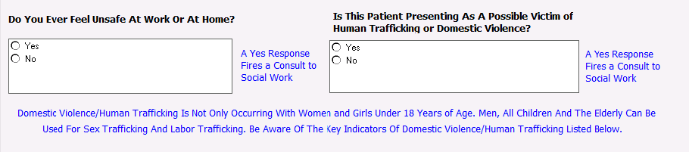
Assessment for Domestic Violence
Adult Nursing History
Domestic Violence

Slide 41
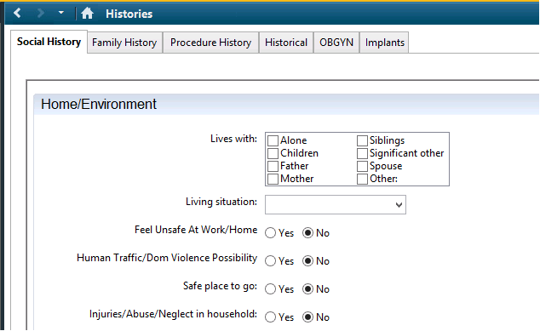
Nursing Assessment
CERNER Social Histories
Domestic Violence

Slide 42
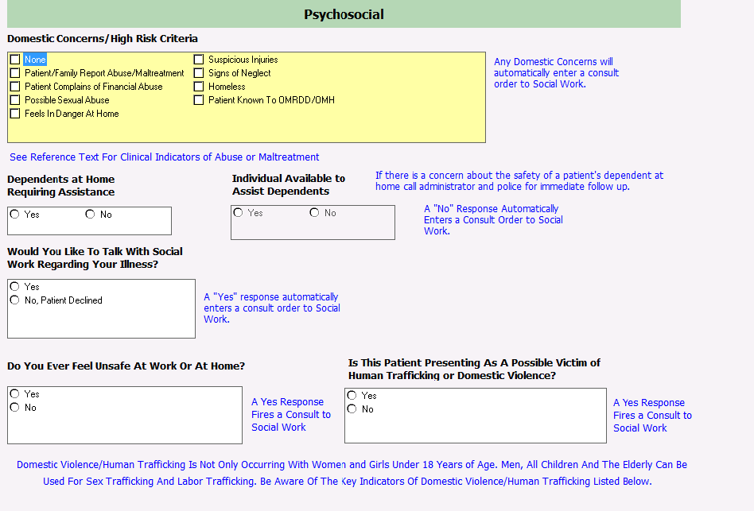
Nursing Assessment for
Domestic Violence
Domestic Violence

Slide 43
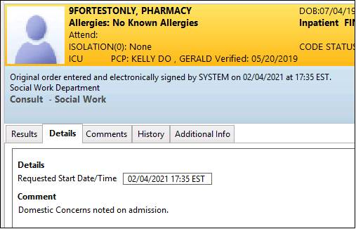
Social Work Consult
Domestic Violence

Slide 44
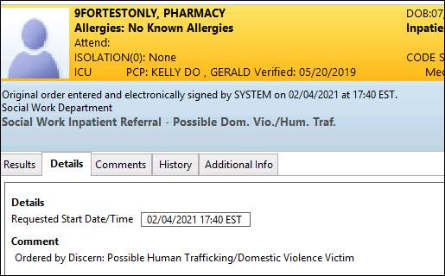
Human Trafficking/
Domestic Violence Consult
Domestic Violence

Slide 45
Role of Social Work
Social Work is called to respond to suspected or confirmed cases of Domestic Violence*:
    Assist finding a safe place to go away from the violence if patient wishes to go
    Counseling and Crisis intervention
    Safety Planning for self and family
    Assessment in regards to safety of children if applicable
    Give information about resources in the community, including housing, financial help, legal services
    Give pertinent information and resources in regards to legal rights such as order of protection process, etc.
    Referral to other resources such as mental health, drugs and alcohol as indicated
* In the case of a sexual assault case a SANE nurse and Police will be involved BEFORE Social Work in order to get forensic evidence and clear, unbiased story and testimony. Social Work will remain available for counseling and crisis intervention after SANE and Police work is completed.
Domestic Violence

Slide 46
Intervention Questions
The American Medical Association, which suggests phrasing questions in your own words, offers the following examples:
    Are you in a relationship in which you've been physically hurt or threatened by your partner? Have you ever been in such a relationship?
    Are you (have you ever been) in a relationship in which you felt you were treated badly? In what ways?
    Has your partner ever destroyed things you cared about?
    Has your partner ever forced you to have sex when you didn't want to? Have you been forced to engage in sex that makes you feel uncomfortable?
    We all fight at home. What happens when you and your partner fight or disagree?
    Do you ever feel afraid of your partner?
Domestic Violence

Slide 47

Intervention Ideas
I'll say something like, “What you've just told me doesn't explain your injury. Is there a reason you're hesitant to tell me more about it? Is there something else you'd like to say?”
Sometimes that helps the patient realize that you're trustworthy and she can tell you what's happening to her.
Domestic Violence

Slide 48
Future Domestic Violence Screen
Increasingly, medical groups and hospitals are developing their own domestic violence protocols.
HITS:
Does your partner Hurt you?
Insult you or talk down to you?
Threaten you with harm?
Scream or curse at you?
The questioner scores one point if the answer is "never“, two points if the answer is "rarely“, three points for "sometimes, ,four points for "fairly often“, and five points for "frequently“.
A total score of more than 10 points indicates abuse.
Domestic Violence

Slide 49
Reportable Injuries
Injury Reporting Laws:
New York State's Penal Law requires that:
All injuries resulting from discharge of a firearm, and all potentially life-threatening injuries inflicted by a knife or other sharp object, must be reported to the local police. (§265.25)
All 2nd or 3rd degree burns to 5% or more of the body, all respiratory tract burns, and all burns which might result in death, must be reported in writing within 72 hours to the Office of Fire Prevention and Control. (§265.26)
These reports must be made by the physician or manager in charge of the case, and intentional failure to report is a class A misdemeanor.
There is no mandatory reporting of adult domestic violence in New York State.
Domestic Violence

Slide 50
Indicators of Domestic Violence - Physical Abuse
Signs and Symptoms of Physical Abuse
Old bruises
Explanation inconsistent with injury
Injuries to face, arms, neck, throat, chest, abdomen or pelvic area
Bilateral bruises
Burns in unusual shapes, sizes, or locations
Injuries in different stages of healing
Have frequent injuries, with the excuse of “accidents”
Dress in clothing designed to hide bruises or scars (e.g. wearing long sleeves in the summer or sunglasses indoors)
Domestic Violence

Slide 51
Domestic Violence - Indicators of Sexual Abuse
Indicators of Sexual Abuse;
Behavioral Signs of Domestic Violence
Recurrent urinary tract infections
Bruising, bleeding, pain, or itching in the genital area (may also be seen in anus, mouth, or throat)
Presence of sexually transmitted disease
Stained, torn, or bloody undergarments
Vaginal discharge and/or odor
Vaginal Bleeding not related to menses
Indicators of Domestic Violence - Behavioral Signs
Possible Behaviors of Victim:
Quiet, non verbal, letting partner do “all the talking”.
Talk about partners “temper” or fear of retaliation.
Unwillingness to communicate.
Depression, anxiety, or suicidal ideation.
Change in sleep, eating patterns.
Increase in alcohol/drug use.
Domestic Violence

Slide 52
General Presenting Issues
Headache or migraine
Increased depression or anxiety
Increased substance use
Recent noticeable weight gain or loss
Abdominal pain
Pelvic pain
Upset stomach or other gastrointestinal issues
Dizziness
Insomnia and other sleep disturbances
General malaise
Unexplained bruises
Multiple bruises( different stages of healing)
Evasive answers
Injuries that aren't consistent with the story being told
Multiple visits to ED
Domestic Violence

Slide 53
Signs and Symptoms of Domestic Violence
Other Signs and Symptoms of Domestic Violence
Panic or depression
Injuries in various stages of healing.
Pattern injuries—those in which a hand or finger mark, or a shoe tip, belt buckle, signet ring, cord, or other object is outlined on the body.
Defensive injuries, such as those to the midulnar region.
Injuries to the head, neck, upper body, and,
in pregnant women, the abdominal area.
Overbearing partner
Partner who won’t leave patient’s side
Partner who won’t let the patient answer for herself
Partner who seems to control what the patient is saying or corrects the patient
Stories that differ in regards to injury
Domestic Violence

Slide 54
Who Do You Contact?
Unlike Child Abuse, there is no “mandated reporter” duty for Adult Family Violence.
POLICE: In situations with severe injuries such as stabbing, gunshot, or multiple trauma the police need to be contacted. If you think the person is in imminent danger, contact the police (911 gets our Stony Brook Police who triage to the local precincts as needed).
In other situations the victim needs to consent prior to a call to police or any other response agency.
Contact Social Worker by calling the Office at 4-2552 during normal business hours and on weekend days or by paging the On Call Social Worker via the operator on off hours.
For patients of Sexual Assault with patient consent- Contact the SANE nurse via the operator and/or VIBS Emergency Room Companion Program at their hot line number (631)360-3606.
The SANE nurse is involved in collection of evidence and clinical exam while the ERC provides emotional support, information and referrals.
Domestic Violence

Slide 55


External Resources - Domestic Violence
http://www.suffolkcountyny.gov/Departments/CountyExecutive/WomensServices/STOPViolence.aspx
VIBS: 24-Hour Hotlines, 7 days a week: (631) 360-3606, (631) 360-3607 ask for HOPE
Brighter Tomorrows 24-Hour Hotline, 7 days a week: (631) 666-8833 ask for HOPE
You can also call (631) 666-7181
Retreat 24-Hour Hotline, 7 days a week (Hotline) (631) 329-2200
Domestic Violence

Slide 56





Elder Abuse
Elder Abuse

Slide 57
Elder Abuse Statistics
Data on elder abuse in domestic settings suggest that only 1 in 14 incidents, come to the attention of authorities.
There is an estimated 5 million elder abuse cases a year in the United States.
Most abusers are family members (70%), most commonly adult children (40%).
Every year approximately 5 million older Americans are victims of physical, psychological and/or other forms of abuse and neglect
Older adults who require assistance with daily life activities are at increased risk of being emotional abused or financially exploited.
Approximately 50% of older adults with dementia are mistreated or abused.
An estimated 13.5% of older adults have suffered emotional abuse since the age of 60.
Victims of elder financial abuse lost an estimated $3.2 billion in 2015.
Elder Abuse

Slide 58
Seven Types of Elder Abuse
Physical abuse. Use of physical force that may result in bodily injury, physical pain, or impairment. Can also include force feeding, and physical restraints.
Sexual Abuse. Non-consensual sexual contact of any kind with an elderly person.
Emotional Abuse. Infliction of anguish, pain, or distress through verbal or non-verbal acts. Includes insults, threats, intimidation, humiliation and harassment and non physical punishment. Silent treatment and enforced social isolation are also examples.
Financial/Material Exploitation. Illegal or improper use of an elder's funds, property, or assets including cashing their check without permission, coercing or deceiving an older person into signing any document.
Neglect. Refusal, or failure, to fulfill any part of a person’s obligations or duties to an elderly person. Neglect also includes situations where a caregiver refuses to pay for or set up necessary home care or other services.
Abandonment. The desertion of an elderly person by an individual who has assumed responsibility for providing care for an elder, or by a person with physical custody of an elder.
Self Neglect. Characterized as the behavior of an elderly person that threatens their own health or safety. Self negect generally manifest itself in an older person as a refusal or failure to provide themselves with adequate food, water, clothing, shelter, personal hygiene, medication and safety precautions.
Elder Abuse

Slide 59
Indicators of Elder Abuse - Neglect
Unusual weight loss, malnutrition, dehydration
Untreated physical problems such as bed sores
Unsanitary living conditions: dirt, bugs, soiled bedding and clothes
Being left dirty or unbathed
Unsuitable clothing or covering for the weather
Unsafe living conditions (no heat or running water; faulty electrical wiring, other fire hazards)
Over or under medicated
Lack of home care even though indicated
Lack of necessary and indicated services
Elder Abuse

Slide 60
Indicators of Elder Abuse - Financial
Significant withdrawals from the elder’s accounts
Sudden changes in the elder’s financial status, large or consistent withdrawals
Homelessness,
Inability to pay utilities, rent or other bills,
Suspicious changes in wills, power of attorney, and policies,
Financial activity the senior couldn’t have done, such as an ATM withdrawal when the account holder is bedridden
Increase in anxiety when the elder is discussing finances
Care takers refusal to plan for necessary patient care
Unapproved and suspicious changes in titles, car, real estate etc.
Elder Abuse

Slide 61
Indicators of Elder Abuse –
Sexual & Physical
Indicators of Elder Abuse - Sexual
Bruises around breasts or genitals
Bruises between legs and on buttocks or lower back
Unexplained venereal disease or genital infections
Unexplained vaginal or anal bleeding
Torn, stained, or bloody underclothing
Indicators of Elder Abuse - Physical
Bruises, pressure marks, broken bones, abrasions, and burns
Bruises at different stages of healing
Explanation not matching injury
Changing story in regards to origin of injury
Frequent presentation with injuries
Bilateral bruising or “wrap around” bruising
Broken eyeglasses or frames
Signs of being restrained, such as rope marks on wrists
Caregiver’s refusal to allow you to see the elder alone
Elder Abuse

Slide 62
Other Indicators of Elder Abuse
& Resources
Emotional Elder Abuse
Behavior such as belittling, threats, harassment and intimidation
Humiliation and ridicule by the caretaker
Ignoring of the elderly person by the caretaker
Isolating an elder from friends or activities
Terrorizing or menacing the elderly person
Strained or tense relationships, frequent arguments between the caregiver and elderly person
Elderly person’s increased anxiety or depression
Elder Abuse

Slide 63
Signs of Abandonment & Self Neglect
Abandonment:
Change in appearance, weight loss, unkempt
Sudden changes address
Unclear care giver situation
Homelessness
Inability to reach family
Family refusing to pick up patient
Family in disagreement with discharge plan of care and unavailable for discharge
Self Neglect:
Refusal to allow treatment
Not getting necessary medical care
Refusal to obtain medication
Not eating to the point of malnourishment
Poor hygiene
Living in dirty, unsanitary, or hazardous condition
Increased alcohol or drug use
Elder Abuse

Slide 64
Local Resources
Elder Abuse Resources:
Suffolk County Office for the Aging
(631) 853-8200
Adult Protective Services
(631) 854-3195
Elder Abuse

Slide 65
Internal Contacts & Questions
Social Work Domestic Violence & Child Protection
Main Social Work Office: (631) 444-2552
Susan McCarthy, Director of Social Work(631) 444-3215
JoAnn McCaslin, Assistant Director Social Work (631) 444-2587
Shatara Jean, Social Work Supervisor (631) 444-3104
Geoffrey O’Connell, Out-Patient Social Work Supervisor (631) 444-4343
Michelle Tepper, Clinical Instructor Emergency Department/Clinical Supervisor Suffolk County SANE and Forensic Nurse Services (631) 965-9568
Dr. Gillian Hopgood, DO, FAAP Child Abuse Pediatrics (631) 216-8310, (631) 873-7898
Contacts

