Slide 1
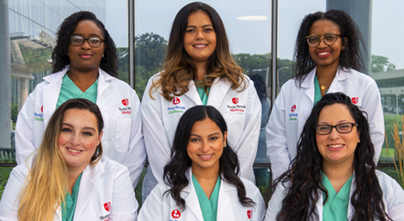
Neonatology/Perinatology Fellows Stony Brook University

Slide 2
Third Year Fellows

Slide 3
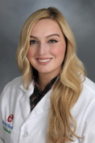
Lale Akaydin, MD
What I love about Long Island?
I love being close to my family!
What is my favorite part about fellowship?
The close friendships you get to make!

Slide 4
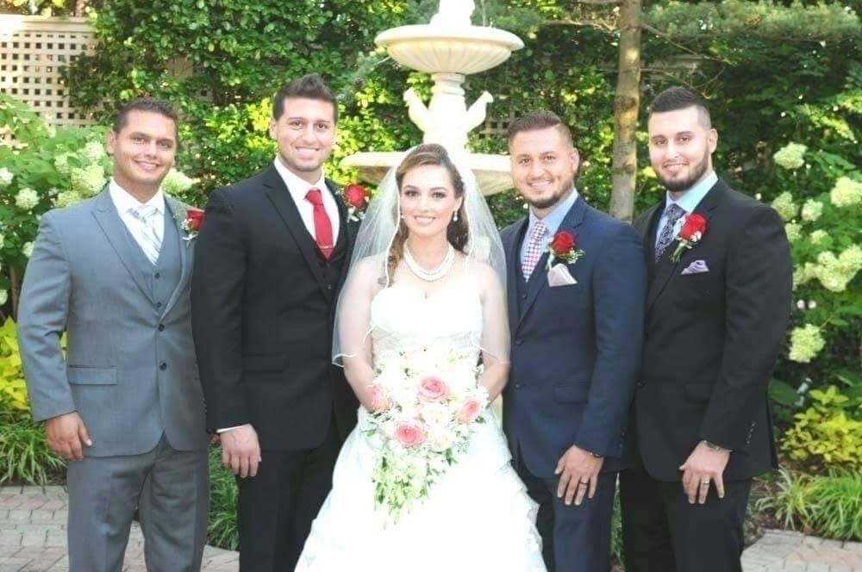
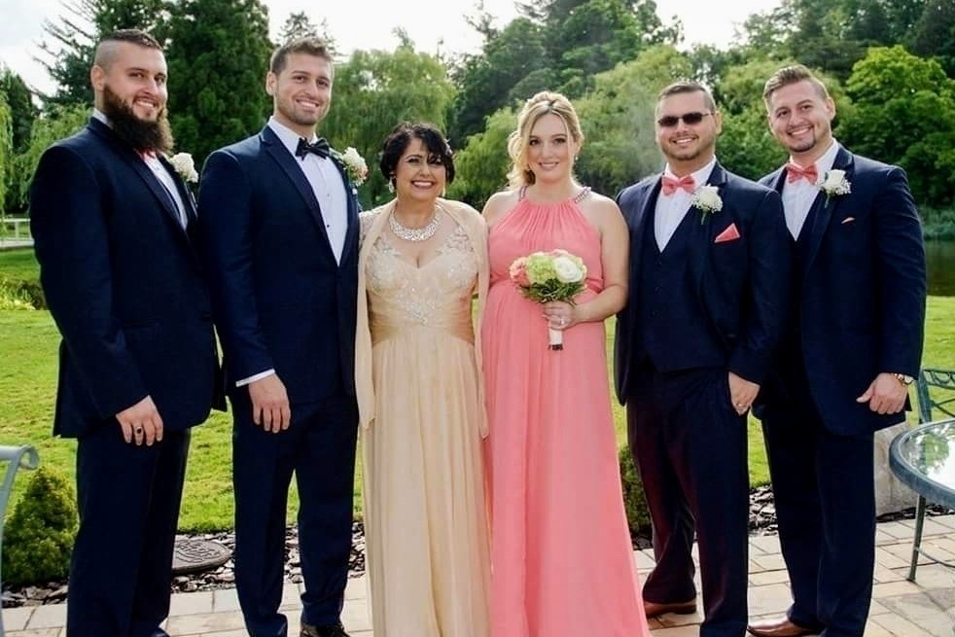
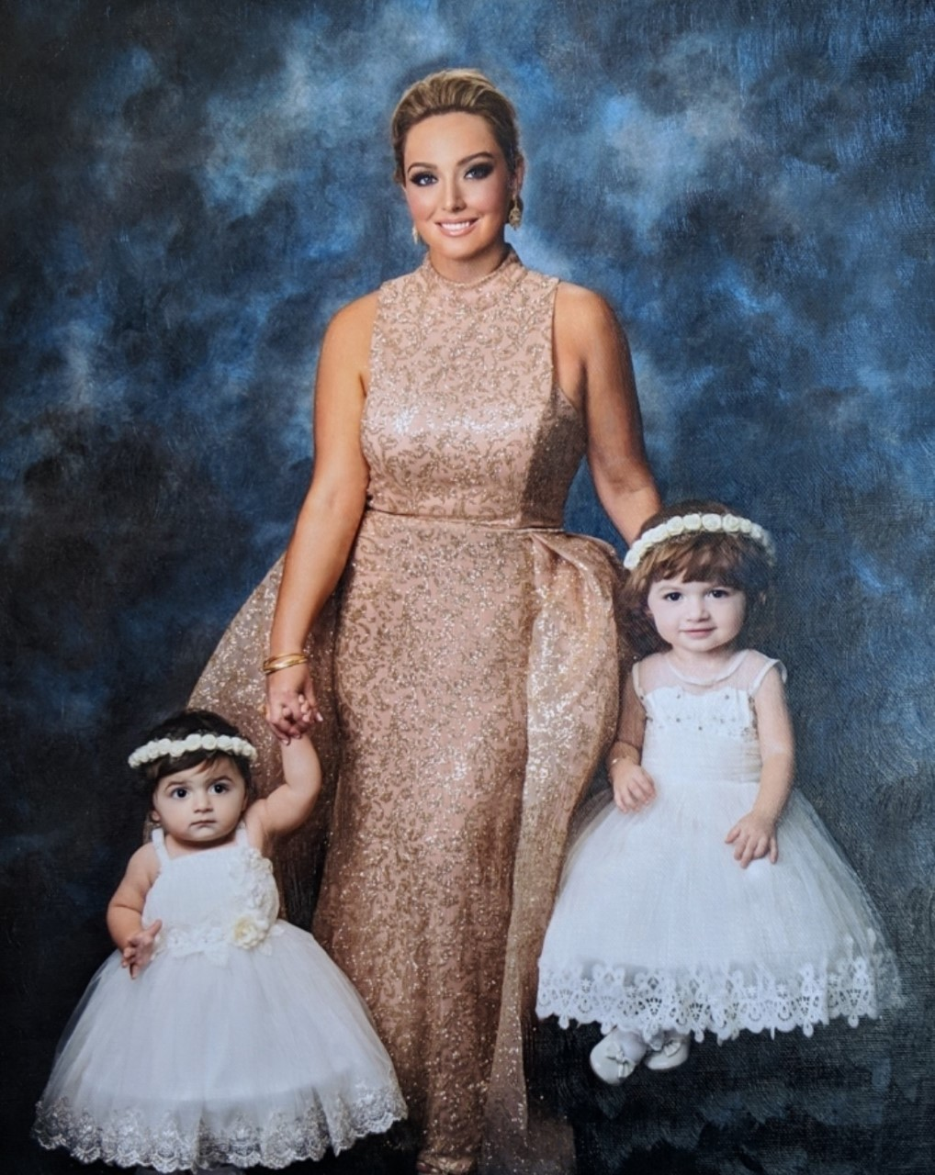
My Family
My Brothers
My Mother

Slide 5
I enjoy volunteering and helping my community
Favorite Quote:
“To laugh often and much; To win the respect of intelligent people
and the affection of children; To earn the appreciation of honest critics
and endure the betrayal of false friends; To appreciate beauty; To find the best in others; To leave the world a bit better, whether by
a healthy child, a garden patch,
or a redeemed social condition; To know even one life has breathed easier
because you have lived - This is to have succeeded.”
--- by Ralph Waldo Emerson

Slide 6
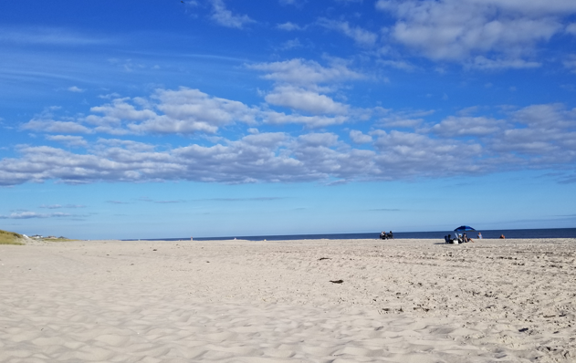
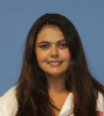
Sarah Mardanlou, MD
What I love about Long Island?
The beaches! There is a beach within 20 minutes from anywhere on the island!
What is my favorite part about fellowship?
I love that the faculty, nurse practioners, and co-fellows are like a huge family! We are so close that it makes going to work fun and entertaining.

Slide 7
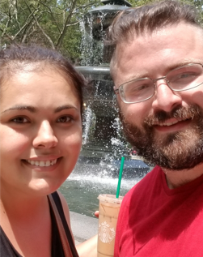
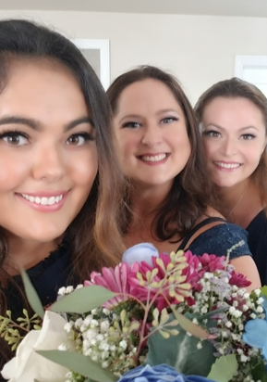
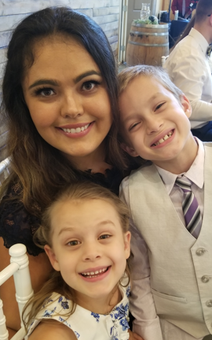
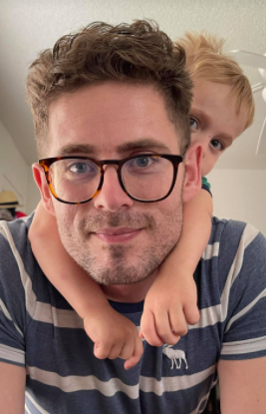
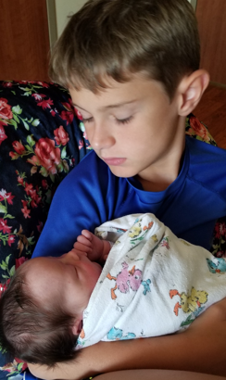
My favorite things in life: Family

Slide 8
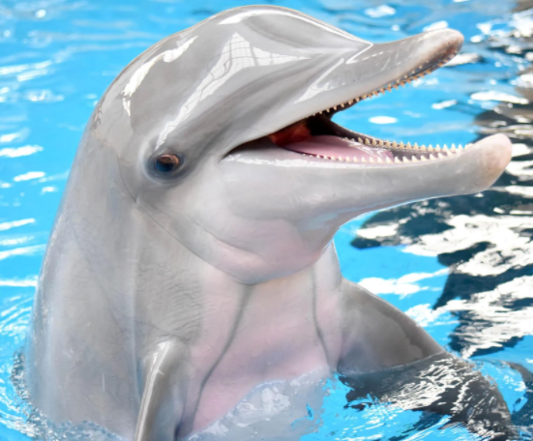
Hogwart’s House:
Team Hufflepuff!!! But I could honestly be any of the houses depending on the day!
What is your spirit animal?
A dolphin! I can even make a noise that sounds just like a dolphin!! Go Flipper!

Slide 9
Second Year Fellows

Slide 10
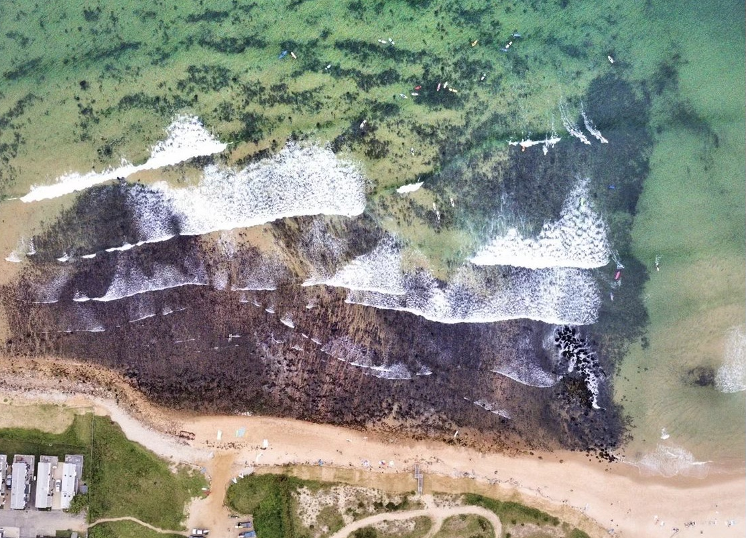
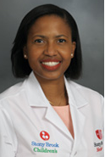
Dionne Donald, MD
What I love about Long Island?
Farmer’s markets, being close to the water and just a train ride away from NYC
What is my favorite part about fellowship?
I love water activities and Long Island is great for that ☺

Slide 11
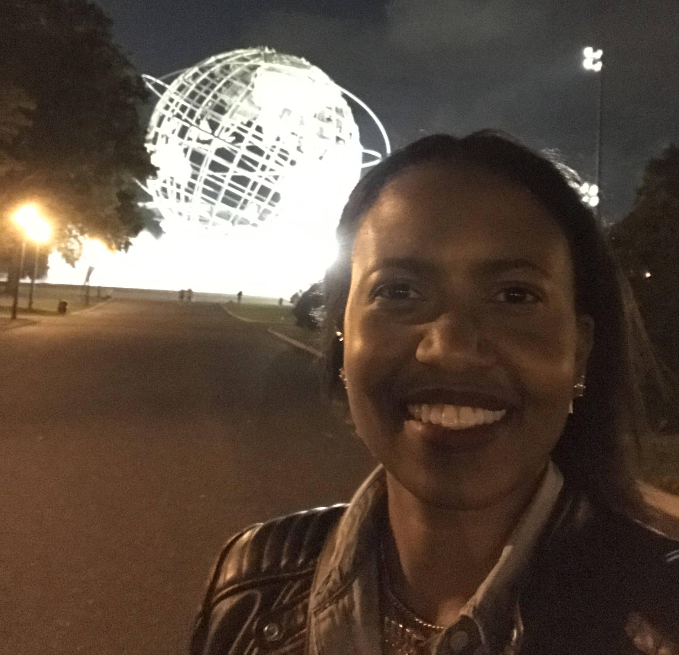
Fun Fact: Originally from the beautiful Spice Isle of Grenada
Secret talent: Talking to babies
What’s your favorite family tradition?
Sunday picnics on Grand Anse Beach
Notes:
NOTE: To change images on this slide, select a picture and delete it. Then click the Insert Picture icon in the placeholder to insert your own image.

Slide 12
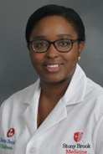
Uzoamaka Ezeanya, MD
What I love about Long Island?
I love that Long Island is not too far from home (New Jersey). My daughter can visit her grandparents and cousins!
What is my favorite part about fellowship?
Hmmm…. my co-fellows. Sometimes we laugh all day that I forget how stressful fellowship really can be. They make all the difference!!

Slide 13
What Matters Most to Me My husband and baby girl!
Notes:
NOTE: To change images on this slide, select a picture and delete it. Then click the Insert Picture icon in the placeholder to insert your own image.

Slide 14
Secret talent?
Acting! An attending feedback after a role play: “Amaka! Don’t take this the wrong way but are you sure you didn’t miss your calling?”. Yeah, I’m that good!
Got any favorite quotes?
Well, outside of biblical verses...
“Never let the fear of striking out keep you from playing the game.”

Slide 15
First Year Fellows

Slide 16
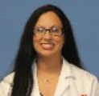
Stergiani (Stella) Agorastos, MD
What I love about Long Island?
Beaches, Fire Island on the 4th of July, Vineyards
What is my favorite part about fellowship?
Procedures, Procedures, Procedures ☺

Slide 17
My Family! My loves!
Notes:
NOTE: To change images on this slide, select a picture and delete it. Then click the Insert Picture icon in the placeholder to insert your own image.

Slide 18
Got any favorite quotes?
Let it be!
What is your favorite family vacation?
Ocean City, Maryland. We love to go to the beach and have a blast eating out at all the new and cool restaurants! We go every year!

Slide 19
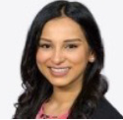
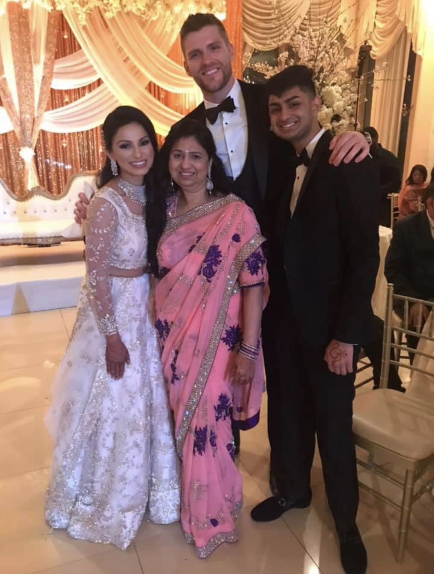
Manasi Dave, MD
What I love about Long Island?
Being close to family & being a short car ride away from the greatest city in the world!

Slide 20
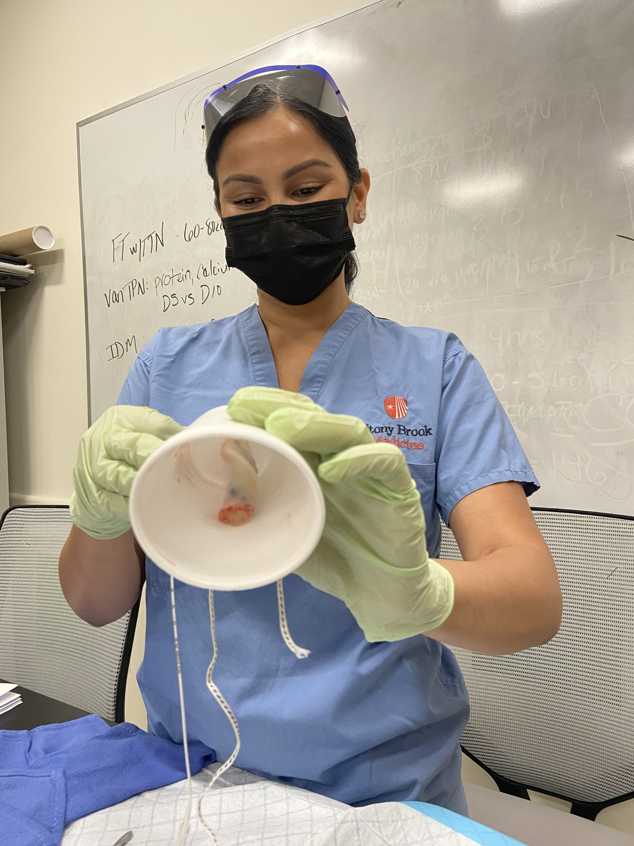
What is the best part about fellowship?
Finally getting to focus on what I want – NICU! Also, the rush you get after successfully resuscitating a newborn in the delivery room!

Slide 21
If money was no object, what would you do all day?
Join a Bollywood dance troupe and dance all day everyday!
What’s something you want to do in the next year that you’ve never done before?
Adopt a puppy!

Slide 22
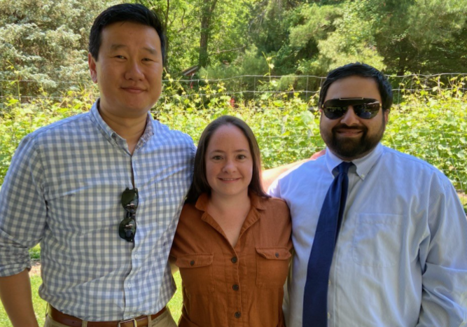
MEET OUR PAST FELLOWS!
Graduates, Class 2021
Ray Lengvilas, MD
Margaret (Meg) Pearce, MD
Hormuz Nicolwala, MD

Slide 23
What was your favorite part about fellowship?
Ray- “My co-fellows! They were the best part of fellowship. The fellows, attendings, and NNPs will be my family forever!”
Meg- “Training alongside an amazing group of people who shared their knowledge and wisdom with us! And of course, my co-fellows, because I couldn’t have done it without them!”
Hormuz- “My favorite part was seeing my co-fellows! It made my day to be surrounded by friends! They are like family!”

