Slide 1
Pain Management at Stony Brook Medicine
E.N. & M.F.
2/2024

Slide 2
Objectives
To review pain assessment.
To review pain management options.
To review TJC Patient preference standard, CMS Core Measure 506, NYS Annual Opioid Antagonist prescription Requirement, PMP
To review resources available at Stony Brook.

Slide 3
PAIN MANAGEMENT POLICY
All patients must have effective pain management.
Patient self report of pain must be source of assessment whenever possible.
Patient’s acceptable level of pain must guide treatment.
Pain is assessed using a population-specific standardized assessment scale.
PC 0039 Pain Management

Slide 4
What is pain?
“An unpleasant sensory and emotional experience associated with actual or potential tissue damage, or described in terms of such damage.”
International Association for the Study of Pain (Merskey, 1979)
Pain is always subjective.
The patient’s self-report of pain is the single most reliable indicator of pain.
2/2024

Slide 5
Determination of pain
If the patient is unable to self report, appropriate behavioral pain assessment tools should be utilized:
N-PASS: NICU
FLACC : pediatrics, Newborn nursery
CPOT: intubated/sedated patients and TBI
PAIN-AD: Geriatrics
Behavioral Pain Assessment Tools

Slide 6
Determinants of pain
The tools look at:
Observable behaviors (facial expressions, body movements, crying)
physiological measures (heart rate and blood pressure).

Slide 7
Pain assessment
Initial Pain Assessment should include:
Location(s) , Intensity , Sensory quality , Alleviating and aggravating factors
Any new onset of pain requires a new comprehensive pain assessment.
Assume Pain is Present (APP):
Term used to document pain in a patient who cannot self report pain.
The patient undergoing a procedure would be
assumed to have pain
2/2024

Slide 8
PAIn re-assessment
Pain Re-assessment:
Every shift minimally-pain score, sedation score, and respiratory rate/assessment.
IV: within 15-30 minutes of administration of dose.
PO/IM/SC: within 1 hour of administration of dose
2/2024

Slide 9
ACUTE PAIN
Acute pain presents most often with a clear cause, relatively brief in duration and subsides as healing takes place.
Acute pain is often accompanied by observable, objective signs of pain:
increased pulse rate
increased blood pressure
Non-verbal signs and symptoms such as facial expressions and tense muscles.
2/2024

Slide 10
Common Acute pain conditions
Acute Postoperative Pain
Pain due to trauma
Sickle cell painful crisis
Acute pancreatitis
Acute on top of chronic like exacerbation of chronic back pain
2/2024

Slide 11
Chronic pain
Pain that is persistent and recurrent.
When pain persists, it serves no useful purpose and may dramatically decrease the quality of life and function.
Chronic pain rarely has any observable or behavioral signs, although persons may appear anxious or depressed.
2/2024

Slide 12
Cancer pain
Pain that is associated with cancer or cancer treatment.
May be attributed to:
Tumor location
Chemotherapy
Radiation therapy
Surgical treatment
2/2024

Slide 13
Responsible Opioid Prescribing
There is a national epidemic occurring involving the misuse, abuse, and diversion of prescription opioids.
The majority of these medications enter circulation through legitimate prescriptions by physicians from all specialties.
Prescribers must be aware that their opioid prescription could potentially end up being used for reasons not prescribed (sold, snorted, traded).
2/2024

Slide 14
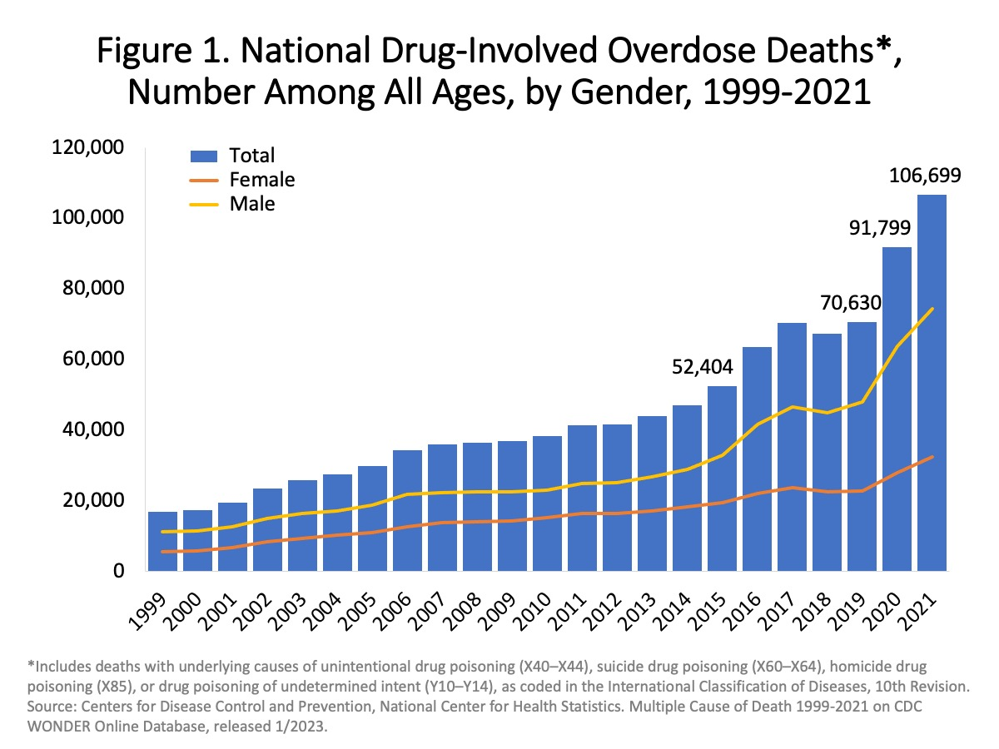
Concerns regarding increasing
overdose deaths
1999-2021

Slide 15
CMS CORE MEASURE
The US government declared the opioid epidemic a public health emergency in 2017. ​
In 2023, 108,000 died from an opioid overdose.​
About 20% of deaths are from prescription drug abuse.
CMS has identified an increased risk of overdose when patients are discharged with two opioids or an opioid and a benzodiazepine and subsequently are monitoring discharge orders for two opioids or an opioid and a benzodiazepine. (Exception cancer/palliative patients)CMS Core Measure 506
2/2024

Slide 16
Pain management approach
Should be interdisciplinary and multimodal.
Care is individualized
GOAL OF PAIN MANAGEMENT:
MANAGING PATIENT EXPECTATIONS
Maintain patient safety
Optimize patient function
Decrease pain score
2/2024

Slide 17
RISK FACTORS FOR OPIOID USE
Age > 60
Pre-existing Respiratory disorders: Sleep apnea and COPD
Pre-existing cardiac disease, especially chronic heart failure.
Opioid Naïve patients.
Concurrent use of sedatives or opioids.
Thoracic or surgical incisions may impair breathing
Risk Factors

Slide 18
Multimodal Analgesia
This term describes the use of multiple modalities to provide pain relief with various parts of the pain pathway targeted.
Decreased dependence on single modality agents decrease the risk of side
effects.
2/2024

Slide 19
PAIN Management options
Treatment options:
Pain Management
Pharmacological
Nerve Blocks
Physical
Heat and cold
Acupuncture
TENs
Relaxation techniques
2/2024

Slide 20
Treatment options
Pharmacological
Acetaminophen
NSAIDs
Opioids
Pharmacological:
2/2024

Slide 21
PHARMACOLOGIC MANAGEMENT
Principles of the WHO pain management:
By the clock
By the mouth
By the ladder

Slide 22
Pharmacological Management
Nonopioid medications ( Acetaminophen and NSAIDs ) should be:
Prescribed first unless contraindicated
Around the clock.
Opioids are prescribed as needed and only if the pain is severe.
2/2024

Slide 23
Non-steroidal anti-inflammatory drugs
NSAIDS:
Non-Steroidal Anti-inflammatory Drugs
NSAIDS
Non-Selective
COX1 & COX2
Ibuprofen
Toradol ( Ketorolac)
Selective
Cox2 Only
Celecoxib
2/2024

Slide 24
NSAIDs
Nonsteroidal Anti-inflammatory drugs can have significant opioid-sparing effects that can be close to 50%.
Contraindications:
History of peptic ulcers and gastrointestinal bleeding, celecoxib may be used with caution.
Renal impairment
Pregnancy
Severe coronary heart disease : use with caution, especially the celecoxib.
2/2024

Slide 25
NSAIDS/ acetaminophen
Acetaminophen is available in the oral and IV form (Ofirmev).
NSAIDS are mostly oral.
Intravenous NSAIDs : Ketorolac ( Toradol ) and Ibuprofen (Caldolor).
2/2024

Slide 26
Adjuvant analgesics
(co-analgesics)
Medications were initially developed for a primary indication other than pain.
Secondary effects of analgesia, e.g.
Antidepressants : e.g. Amitriptyline, Duloxetine
Anticonvulsants: Gabapentin
Steroids
Muscle relaxants
2/2024

Slide 27
Patient preference
TJC Standard: Patient Preference
The patient can choose a lower dose, lower potency(Tylenol instead of an opioid) or less invasive route of medication for pain.
In order to meet the standard:
1-The prescriber must have a “patient preference order” prescribed. It is listed under the medication orders. The patient preference order can be used whenever there are pain medications ordered for different levels of pain.
2-The RN needs to document on the MAR under comments that the medication of lower dose, potency or less invasive route was given due to patient preference.
3-This standard does not allow for patient choice in higher doses or more invasive route of medication for pain.
2/2024

Slide 28
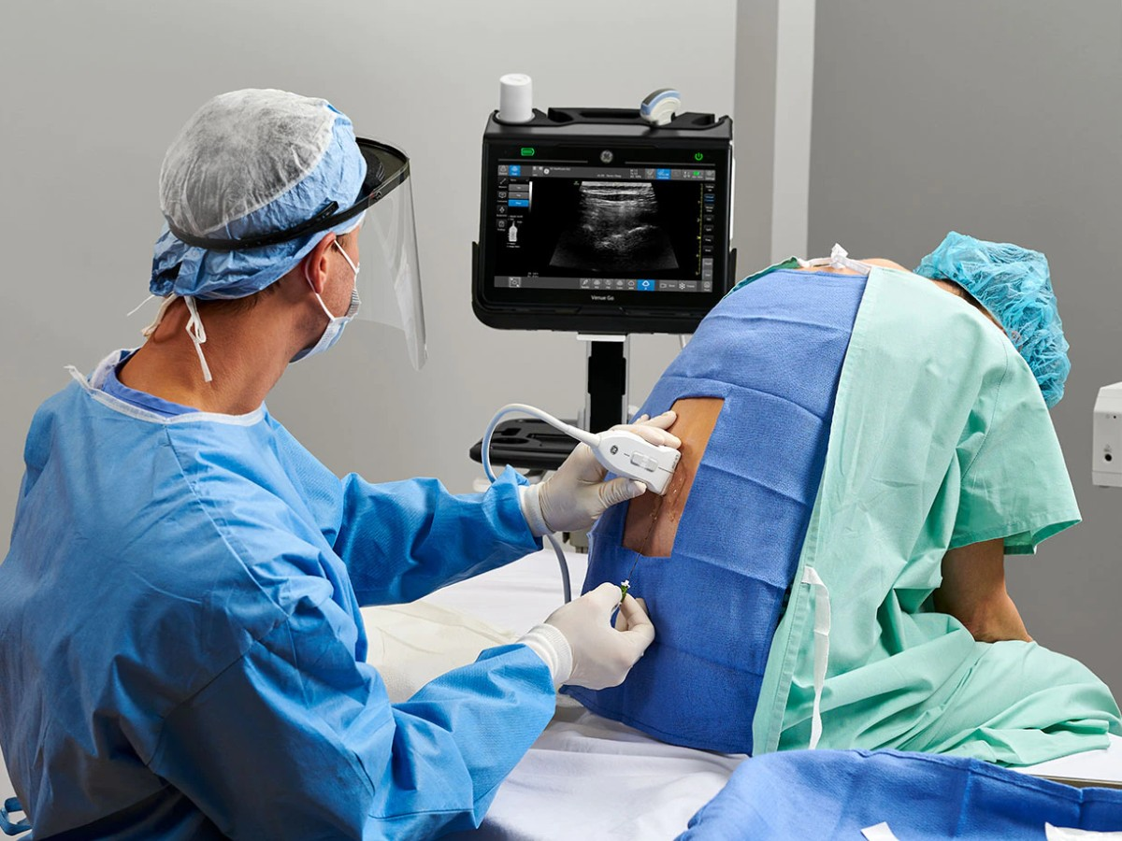
opioid Sparing Procedures
Opioid Sparing Procedures
2/2024

Slide 29
Nerve Blocks
These blocks are used for acute postoperative pain or pain due to trauma.
The acute pain service anesthesiologist provides them. They can be placed in almost any region of the body.
Nerve catheters can be placed to prolong the nerve block and analgesia if the patient stays in the hospital.
2/2024

Slide 30
Patient education
TJC requires patient education on:
Pain Management plan for discharge
Safe use of opioids-Taking medications as prescribed, no sharing of medications, avoid driving or activities requiring attention when taking opioids, educate on use of naloxone if discharging home with it
Storage and disposal of opioids-Store preferably in a lock box. Proper disposal of fentanyl patches. Take back program to dispose of unused opioids.
2/2024

Slide 31
Responsible Opioid Prescribing-identifying risk of substance abuse
Doctor Shopping: Using more than one doctor to obtain opioids
Prevent by checking databases
1. External medication history on EMR
2. New York State Prescription Drug Monitoring System
NYS requires all providers who prescribe opioids to check the PMP
prior to ordering opioids.
Link found on The Pulse, under Resources : I-STOP NYSPMP (Prescription Monitoring Program / Registry)
To sign up for NYS PMP: https://commerce.health.state.ny.us/hcsportal/appmanager/hcs/home
1-866-529-1890 (M-F 8-4:45pm)
2/2024

Slide 32
Responsible Opioid Prescribing
NYS Public Health Law section 3309(7) requires prescribers to prescribe an opioid antagonist with the first opioid prescription each year in patients:
History of substance use disorder
High dose, cumulative prescriptions of 90 morphine equivalents or higher per day
Concurrent use of opioids and benzodiazepine or sedative hypnotics

Slide 33
RESOURCES Acute Pain Service
Provides 7 days per week, 24-hour consultative services every day of the year.
Manages IV PCA, epidural catheters, nerve block catheters, and ketamine infusions for pain.
Page Acute Pain Beeper( Pain PCA) for assistance.
2/2024

Slide 34
Acute Pain Service
The Acute Pain Service must be notified for:
Patients who report an indwelling device for pain management (e.g. , intrathecal pain pump or spinal cord stimulator).
Any pre-surgical patient who is followed by an outpatient pain clinic.
Any pre-surgical patient who is opioid tolerant: receiving long-acting/controlled-release narcotics
Any pre-surgical patient who reports or tests positive for illicit drug use.
2/2024

Slide 35
SBUMC – Center for Pain Management
The Chronic Pain Center is located in the “Center for Pain Management” at Smithhaven Mall
Call 638–PAIN to make an appointment for an outpatient consultation
Treatments offered:
Chronic non-urgent cases, e.g., chronic back pain, phantom pain, chronic persistent pain.
Treatment is mainly interventional. Epidural steroids, facet injection, stellate ganglion block.
Refill of intrathecal pumps, follow-up of spinal cord stimulators.
2/2024

Slide 36
Psychiatry
Call 4-3408 for a consult.
Contact for assistance:
With opioid withdrawal (IVDA, methadone)
To start medication-assisted therapy (MAT): suboxone and methadone.
Social work can assist with setting up referrals to outside methadone clinics or suboxone providers.
Can assist with the control of anxiety or depression, which impacts controlling pain.
2/2024

Slide 37
References /policy
PC 0039 Pain Management Policy
The Joint Commission. R3 Report/ Requirement, Rationale, Reference: A complimentary publication of the Joint Commission-Pain assessment and management standards for critical access hospitals.
NYS Annual opioid antagonist Prescription Requirement-Effective June 2022
CMS Core Measure 506: Safe Use of Opioids
2/2024

