Slide 1
Practitioner Impairment
Taking a proactive approach to practitioner impairment
Updated 2/23

Slide 2
Definition of Impairment
An impaired physician is one who is unable to practice medicine with reasonable skill and safety because of a mental illness; a physical illness or condition that adversely affects cognitive, motor, or perceptive skills; or substance abuse.
Federation of State Medical Boards of the United States, Inc. Report of the ad hoc committee on physician impairment. June 2005
r

Slide 3
Definitions of Professional Misconduct
Education Law, Section 6530 (7) & (8)
Practicing the profession while impaired by alcohol, drugs, physical disability, or mental disability
Being a habitual abuser of alcohol, or being dependent on or a habitual user of other drugs, except a physician who is maintained on an approved therapeutic regimen which does not impair the ability to practice

Slide 4
YES, it can happen to you!!!!
Estimates suggest that impairment related to a substance use disorder will affect 8% to 18% of physicians sometime during their life and that about 2% of physicians currently have an active problem with substance use
Boisaubin EV, Levine RE. Identifying and assisting the impaired physician. Am J Med Sci 2001; 322(1):31-6
Other data indicate that rates of alcohol use disorders among physicians are equal to or greater than the general population:
21.4% - 25.6% among female physicians
12.9% - 13.9% among male physicians
Oreskovich MR, Shanafelt T, et al. The prevalence of substance use disorders in American physicians. Am J Addict. 2015;24:30-8
Oreskovich MR, Kaups KL, et al. Prevalence of alcohol use disorders among American surgeons. Arch Surg. 2012;147:168-74.

Slide 5
Not all impaired physicians become part of these statistics.
Some physicians have an impairment that is not obvious to others and are not involved in treatment.
Others may have sought treatment on their own and in confidence.
Still others may continue to practice with impairments while being "protected' by well-intentioned family members, friends, and colleagues.

Slide 6
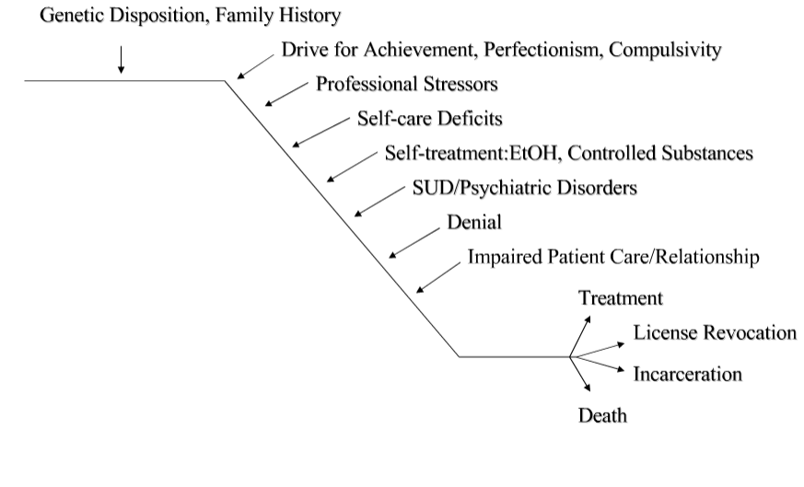
The “slippery slope” to physician impairment

Slide 7
Profile of Addiction
Compulsive seeking & use of prescription or illegal psychoactive substances
Progressively deteriorating course
Continued use despite negative consequences (magnified in medicine)
Tendency to relapse
Requires comprehensive recovery program

Slide 8
Doctors Treating Doctors
Public Health Law 230-11 (e)
Preserves physician/patient privilege even when patient is a doctor or a student
No Office of Physician Medical Conduct (OPMC) report is required for information learned solely as a result of rendering treatment to another physician

Slide 9
Warning Signs
Frequently absent from work, conferences or rounds
Creates improbable excuses for not fulfilling professional obligations.
Rarely admits errors or blame for mistakes
Unexplained absences
Takes long trips to restroom
Unreliable
Difficulty concentrating
Persistent poor judgment
Changes in behavior

Slide 10
Sign and Symptom Patterns
Personal
Change in baseline behavior
Deteriorating personal hygiene
Multiple physical complaints
Unfocused, confused, distracted
Mood swings
Overreaction to performance feedback
Change in speech pattern
Isolation: avoidance of associates

Slide 11
Sign and Symptom Patterns
Hospital
Frequent lateness, absence or illness
Declining work performance
Ignoring requests to catch up on paperwork
Questionable orders
Inappropriate response to patient needs or staff requests
Uncooperative and defiant approach to problems and/or performance feedback
Denial/blaming others for problems
Anger/abusive language
Reports of disruptive behavior

Slide 12
Risk Factors for Impairment
Pharmacological optimism
Knowledge of drug actions
Strong will, invulnerability
Willing to take chances
Believes use can be controlled
Rationalizes inappropriate behavior

Slide 13
Risk Factors for Impairment
Access
Self-medication
Job stress, erratic hours
Perfectionism
Difficulty discussing feelings (relies on denial)
Professional independence
Rationalizes inappropriate behavior

Slide 14
Why We Don’t Seek Help for Ourselves or Each Other
Healthcare practitioners don’t seek help for themselves
Help each other vs. seek outside help
Denial, rationalization
Fear of being exposed and/or losing license, job, income and/or reputation
Shame, embarrassment, guilt

Slide 15
Why We Don’t Seek Help for Ourselves or Each Other
Conspiracy of silence - peers ignore and enable inappropriate behavior
Don’t want to become involved, i.e., “rock the boat”
Believes others are addressing the problem
“I can handle it on my own”
Don’t know where to turn or trust that others will help

Slide 16
Resources
Medical Society for the State of New York
The Committee on Physician Health (CPH)
You may refer your
friend, peer
or yourself....

Slide 17
Confidentiality
If you call CPH about a colleague, your phone call will be held in the strictest confidence.
The identity of a referral source is never revealed unless the caller agrees. All referrals are treated confidentially.
Call 1 (800) 338-1833
Web site http://www.mssny.org/cph/

Slide 18
MSSNY Contact Info
Please call the toll free number (NY State only):
1 (800) 338-1833
Or their office at:
(518) 436-4723
The Committee for Physician Health 99 Washington Avenue, Suite 1111 Albany, NY 12210 Fax: (518) 436-7943 Email: terrv@cphnv.org‭ ‬All calls are confidential!

Slide 19
When behavior is caused by illness.
Treating the illness changes behavior.

Slide 20
Positive Outcomes
Returns to productive practice of medicine
Hospital retains valuable team member
Clinical quality is enhanced
Colleagues’ trust is restored
Communications with staff improves
Practice continues to grow
Professional liability risk is reduced
Restoration of career, health, family, personal life

Slide 21
Additional Resources
SBUH Administrative P&P #MS0011
https://policymanager.uhmc.sunysb.edu/dotNet/documents/?docid=25817
SBUH Practitioner Well Being Committee Committee Chair
631-263-6071
2023

