Slide 1
Early Detection and Treatment of
Severe Sepsis and Septic Shock
Stony Brook University Medical Center
1/23
Notes:
This presentation will review our initiative for the Early Detection and Treatment of Severe Sepsis and Septic Shock

Slide 2
Surviving Severe Sepsis and Septic Shock
More than 1.5 million people get sepsis each year
One in three patients who die in a hospital have sepsis
Severe sepsis is the leading cause of death in the non-coronary ICU
The New York State 2016 Sepsis Care Improvement Initiative reported an overall severe sepsis and septic shock mortality rate of 25%-32%
Notes:
The early identification and management of severe sepsis is important because severe sepsis carries a mortality rate of 30-50% and septic shock a mortality of 50-60%.
Severe sepsis is the leading cause of death in the non-coronary ICU and kills 1400 people worldwide every day.

Slide 3
New York State Department of Health (NYSDOH) Reporting
Effective May 1, 2013 NYSDOH Title 10 New York Codes Rules and Regulations (NYCRR) Sections 405.2 and 405.4 were amended to require that hospitals have in place evidence-based protocols for the early recognition and treatment of patients with severe sepsis and septic shock that are based on generally accepted standards of care.
Population
Inpatient adults (≥18 y/o) and children (<18 y/o).
Diagnoses of Severe Sepsis or Septic Shock
Notes:
General overview of these stats The New York State Department of Health requires that hospitals have in place evidence-based protocols for the early recognition and treatment of patients with severe sepsis and septic shock that are based on generally accepted standards of care. The protocols and reporting of hospital data have been required since May, 2013. The New York State DOH requires that we have protocols and report data on inpatient adults (over the age of 18) and children (18 years of age or less) who are diagnosed with severe sepsis or septic shock

Slide 4
Why This Is Important
Stony Brook must participate in all mandatory Inpatient Quality Reporting Measures
Public Reporting of CMS and NYSDOH data
Notes:
Why is it important that we have a protocol and measure our compliance and outcomes? First and foremost, adherence to protocols or guidelines has been shown to improve patient mortality. In addition, Stony Brook MUST participate in all mandatory Inpatient Quality Reporting Measures, of which SEP-1 is one. Both CMS and the NYSDOH will be publicly reporting our hospital data.

Slide 5
Defining The Septic Picture
SIRS (Systemic inflammatory response syndrome): A clinical syndrome that results from a dysregulated inflammatory response.
Sepsis: SIRS caused by a proven, or suspected infection. Positive cultures add to the validity but are not required for the diagnosis.
Severe Sepsis: Sepsis plus evidence of organ dysfunction that is new, and not explained by other etiology.
Septic Shock: Severe sepsis associated with persistent hypotension (BP < 90/60 mmHg) despite adequate fluid resuscitation and/or a serum lactate level >=4.0 mmol/L
Notes:
How do we define sepsis?
The Systemic Inflammatory Response Syndrome, or SIRS, is a clinical syndrome resulting from a dysregulated inflammatory response, which may be due to an infectious or noninfectious etiology such as trauma, burns or pancreatitis, for example.
Sepsis is SIRS that is secondary to an infection and is a clinical diagnosis. Positive cultures are helpful, but not required.
Severe sepsis is sepsis plus at least one sign of organ dysfunction that is new and not explained by another known etiology.
Septic shock is severe sepsis plus persistent hypotension (BP < 90/60) after fluid resuscitation, and/or a serum lactate level ≥4.0 mmol/L .

Slide 6
Adult Severe Sepsis Criteria All three of the following must be met within 6 hours of each other.
Documentation of a suspected source of clinical infection
B. Two or more manifestations of systemic infection according to the SIRS criteria, which are:
Temperature > 38.3 C/101 F or < 36.0 C/96.8 F
Heart rate > 90 bpm
Respiration > 20 per min
WBC > 12,000 or < 4,000 (k/uL) or > 10% bands
C. Organ dysfunction, evidenced by any one of the following:
SBP < 90 (mmHg), or MAP < 65 (mmHg), or a SBP decrease of more than 40 pts (if documented by LIP as due to infection)
Cr > 2.0 (mg/dL), or urine output < 0.5 mL/kg/hour for 2 hours
Bilirubin > 2 mg/dL (34.2 mmol/L)
Platelet count < 100,000 (k/uL)
INR > 1.5 or a PTT > 60 sec
Lactate > 2 mmol/L (18.0 mg/dL)
Acute respiratory failure requiring a new need for invasive or non-invasive mechanical ventilation
OR Physician/NP/PA documentation of severe sepsis
Notes:
The criteria for Severe Sepsis in adults include documentation of a suspected clinical infection, two or more manifestations of SIRS and new organ dysfunction, all of which occur within 6 hours of each other.
The manifestations of SIRS include fever or hypothermia, tachycardia, tachypnea and elevated or low WBC or increased band count.
Organ dysfunction may manifest as hypotension, elevated creatinine or low urine output, elevated bilirubin, low platelet count, prolonged coagulation tests, respiratory failure or an elevated lactate.
Physician, NP or PA documentation of severe sepsis defines severe sepsis, regardless of the presence of the above criteria.

Slide 8
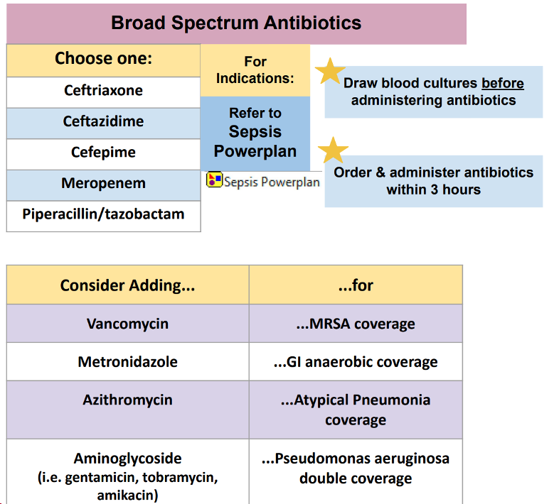

Slide 9
Pregnant 20 weeks through Day 3 Postpartum-delivery Severe Sepsis Criteria All three of the following must be met within 6 hours of each other.
Documentation of a suspected source of clinical infection
B. Two or more manifestations of systemic infection according to the SIRS criteria, which are:
Temperature greater than 38.0 C/100.4 F or < 36.0 C/96.8 F
Heart rate greater than 110 bpm
Respiration greater than 24 per min
White blood cell count greater than 15,000 or less than 4,000 (k/uL) or greater than 10% bands
C. Organ dysfunction, evidenced by any one of the following:
SBP less than 85 mmHg, or Mean arterial pressure less than 65 mmHg.
SBP decrease of more than 40 mmHg
Creatinine greater than 1.2 mg/dL, or urine output less than 0.5 mL/kg/hour for 2 hours
Bilirubin greater than 2 mg/dL (34.2 mmol/L)
Platelet count less than 100,000 k/uL
INR greater than 1.5 or a PTT greater than 60 sec
Lactate greater than 2.0 mmol/L (18.0 mg/dL)
NOTE: Do no use lactate obtained during active delivery defined as documentation of uterine contractions resulting in cervical change (dilation or effacement) through delivery.
Acute respiratory failure requiring invasive or non-invasive mechanical ventilation
OR Physician/NP/PA documentation of severe sepsis

Slide 10
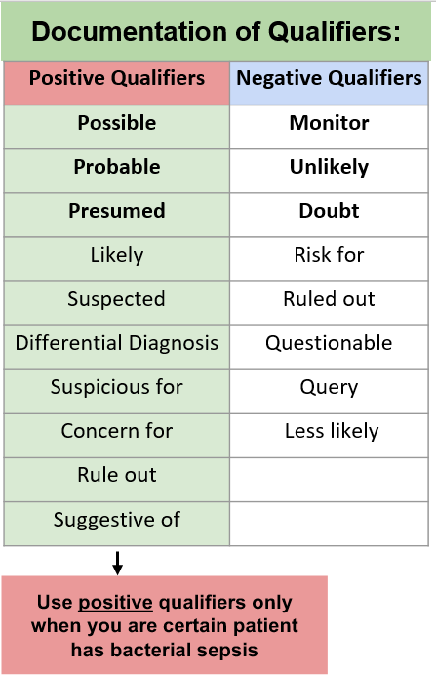
LIP Documentation of Severe Sepsis
Caution:
LIP documentation of “severe sepsis” in a note with or without clinical criteria requires implementation of the sepsis bundle.
If the diagnosis of severe sepsis/septic shock is being considered but is not certain:
Notes:
Documentation of severe sepsis by a provider can define severe sepsis and trigger an audit regardless of the presence of the severe sepsis criteria. Providers should be mindful of documenting severe sepsis, when they mean sepsis, or when the patient is sick due to other reasons.
If unsure whether severe sepsis is present or not, use the qualifiers in the left column as a guideline for expressing that doubt in documentation.
Qualifiers in the right hand column indicate that severe sepsis is likely or being considered as part of the differential and requires implementation of the sepsis bundle

Slide 11
Septic Shock Criteria
• Patient meets Severe Sepsis criteria AND either:
• Lactic acid ≥4 mmol/L
OR
• Persistent Hypotension in the hour following crystalloid fluid bolus
OR
• Physician/Advanced Practitioner diagnosis
Notes:
Septic shock is defined as criteria for Severe Sepsis AND either:
Lactic acid > 4 mmol/L
OR
Persistent hypotension in the hour following a crystalloid fluid bolus of at least 30 ml/kg
OR
Physician or Advanced Practitioner diagnosis documentation

Slide 12
Required Interventions within 3 Hours of Recognition
Initial Lactate Collection
Blood culture collection prior to antibiotic administration
Early, appropriate broad-spectrum antibiotic administration
Notes:
As soon as severe sepsis is identified:
Order an initial lactate.
Order and ensure Blood cultures are collected prior to antibiotic administration.
Order appropriate broad spectrum antibiotics.

Slide 14
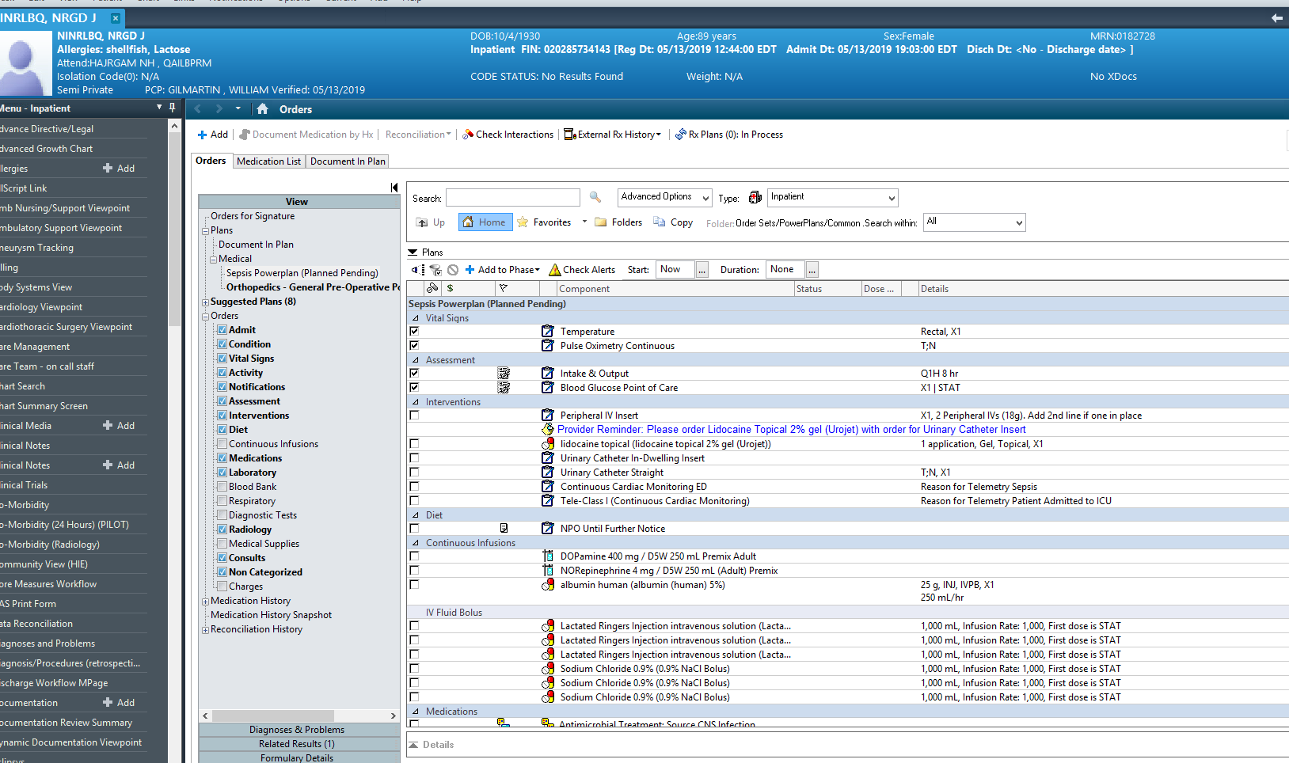
Recognition to Immediate Treatment
The Sepsis Power plan
Notes:
Once severe sepsis or septic shock is recognized, initiate the sepsis power plan in Cerner to facilitate resuscitation and compliance with all of the sepsis bundle elements.

Slide 15
SBM Adult Fluid Order

Slide 16
Fluid Resuscitation
For :
Severe Sepsis + Lactic Acid ≥4 OR
Any episode of hypotension (SBP <90 or MAP<65 mmHg)
Crystalloid fluid resuscitation (30 ml/kg) must be initiated within 3 hours and completed within 6 hours of recognition
Notes:
Appropriate fluid resuscitation requires administration of 30 ml/kg of crystalloids. This must be started within three hours of meeting criteria for severe sepsis with any instance of hypotension or criteria for septic shock. Fluids must be completed within 6 hours of the septic shock presentation.

Slide 18
Interventions for Adults within 6 Hours of Recognition
Re-measure lactate if the initial value was elevated (>2), in 3 hours
If the blood lactate acid result is >2mmol/L an EPR generated order for a redraw is automatically ordered every 3 hours X2.
*Please note in the Emergency Department the second lactate may NOT be automatically reordered if the first was not ordered through the Sepsis Order Set. It then MUST be manually reordered by the admitting LIP.
Initiate vasopressor therapy IF hypotension persists after appropriate fluid resuscitation
Notes:
Within 6 hours of recognition of severe sepsis or septic shock, the lactate must be re-measured if the initial value was > 2.0.
Auto Text is available to easily document a sepsis focused exam in your note. Unless properly timed within a note or via an addendum, the default time stamp used will be the note start time and may cause measure non-compliance

Slide 19
Interventions for Adults within 6 Hours of Recognition
Assess and document volume status and tissue perfusion
A focused exam performed/reviewed by physician/advanced practitioner must be documented, including:
Vital Signs
Cardiopulmonary
Capillary refill
Peripheral pulses
Skin
Use Auto Text:
“.Sepsis” to add focused exam documentation to your note; “A focused sepsis exam was performed.”
Volume status documentation must be time stamped to indicate time of evaluation or otherwise defaults to time when note is started and may fail measure.
Notes:
Within 6 hours of recognition of severe sepsis or septic shock, the lactate must be re-measured if the initial value was > 2.0.
Auto Text is available to easily document a sepsis focused exam in your note. Unless properly timed within a note or via an addendum, the default time stamp used will be the note start time and may cause measure non-compliance

Slide 20
Cerner Lactate Re-Order Rule
When severe sepsis criteria are met and the initial lactic acid result is ≥ 2.1, a repeat Lactic Acid order is required and will be generated automatically by the system.
THESE ORDERS SHOULD NOT BE CANCELLED!!
Remember patients received from the ED must have the second Lactate ordered & manually reentered by the accepting team
Notes:
There is a lactate re-order rule in Cerner. If the initial lactate is > 2.0 the system will generate an order for another lactate. THESE ORDERS SHOULD NOT BE CANCELLED!
If the first result in this system is < 2.0, the second order will not be placed.

Slide 21
Bundle Variance Documentation
Comfort Care measures or patient refusal of care leading to bundle variance must be documented within 6 hour of Severe Sepsis/Septic Shock presentation
Notes:
Documentation of comfort measures or refusal of care, will exclude a patient from completing bundle requirements and must be documented in the patient record.

Slide 22
Notes:
The Sepsis protocol for treatment lists minimum treatment obligations for non-exclusion patients

Slide 23
Electronic Sepsis Screening Alerts
Notes:
The electronic severe sepsis and septic shock sepsis screening alerts facilitate rapid recognition of patients with potential sepsis and to aid in the institution of timely resuscitation and treatment measures.

Slide 24
Cerner Severe Sepsis Screening Alert
This alert will appear whenever a LIP opens the patient’s chart and the following criteria have been met:
2 SIRS criteria + 1 Organ Dysfunction (within 6 hours of each other)
Answering alerts is time sensitive; clock is ticking on bundle compliance!
Primary team providers must answer “agree” or “disagree” that severe sepsis is present (i.e. there is a new suspected or documented infection)
Notes:
The Severe Sepsis Screening Alert will fire when 2 SIRS criteria and one organ dysfunction occur within 6 hours of each other and will appear whenever an LIP opens the patient’s chart.
These alerts MUST be addressed by the primary or cross covering team regardless of the shift the alert fires on.

Slide 25
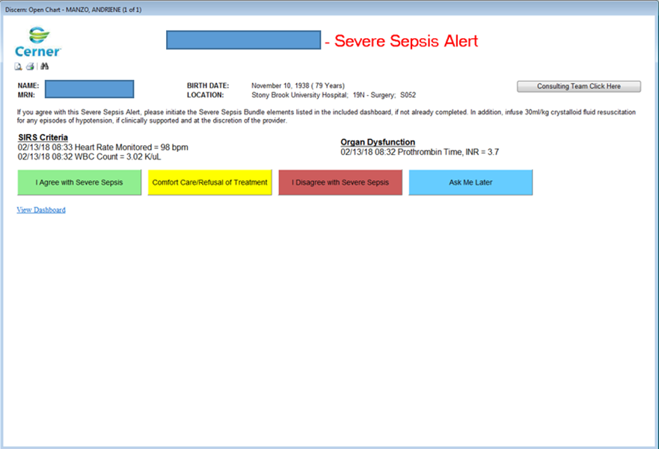
Severe Sepsis Recognition Provider
If “agree” Initiate Sepsis Power Plan
Complete 3 and 6 hour Sepsis Bundle elements respectively.
If “disagree”, the alert will continue to monitor for sepsis elements every 12 hrs.
Indicate if patient is refusing care or comfort measures have been initiated
The “View Dashboard” link will provide a timeline for resuscitation measures and allow the LIP to easily identify components that have not been completed
Notes:
The primary team is responsible for answering the Severe Sepsis alert and should only answer “agree“ if they agree that there is a new episode of severe sepsis; or severe sepsis is being considered high on the differential. Providers should initiate the severe sepsis power plan and sepsis bundle elements if severe sepsis is present or under consideration.
Click disagree if the identified SIRS criteria and organ dysfunction is due to another etiology or are part of an ongoing episode of severe sepsis.
If a patient is on comfort care or is refusing treatment, choose that option on the alert screen to document.
Only Consultants, who are not responsible for the day-to-day management of patients should click on the ”Consulting Team” option.
The Primary Team or Cross Covering team responsible for entering patient orders should NEVER choose consultant as these choices are recorded and monitored.

Slide 26
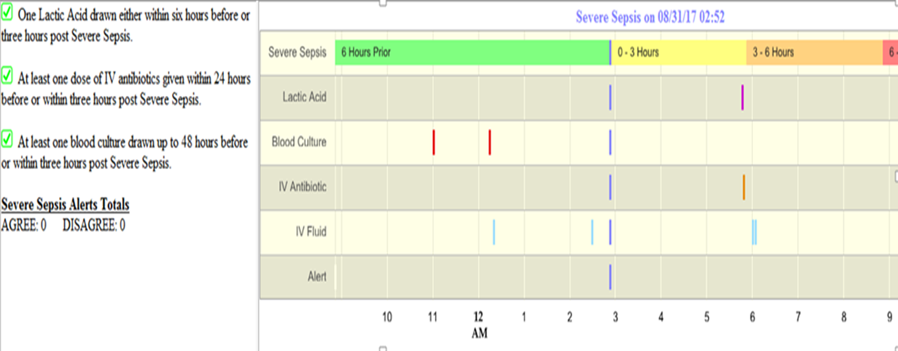
Sepsis Dashboard
Provides visual estimation of when criteria was met or “time zero”
Hovering over lines identifies criteria used to determine severe sepsis presence or intervention details.
Provides timeline for interventions required and visual cues for which interventions are still outstanding
Notes:
The provider assessing the patient should review the electronic sepsis dashboard in the health record. The sepsis dashboard is refreshed every 10 minutes and provides up to date information regarding the ongoing resuscitation effort and on sepsis bundle element completion.
The dashboard also provides an estimate of “time zero” and can look back to the 6 hours prior to pull in appropriate bundle elements that count towards the measure.

Slide 27
Cerner Septic Shock Screening Alert
If the provider has “agreed” to the severe sepsis alert, the Septic Shock Alert will look for:
Lactic acid >4 mmol/L within 6 hours OR
Persistent hypotension
If criteria is found the alert will fire, notifying the provider of potential septic shock.
Notes:
Once the provider has agreed to severe sepsis, the Septic Shock Alert will look for lactate ≥4 within 6 hours. If criteria is found the alert will fire, notifying the provider of potential septic shock.

Slide 28
Septic Shock Alert Documentation
If the provider agrees with the alert, he/she will be prompted to complete a focused exam.
Notes:
When criteria is met, the septic shock alert will fire. If the provider agrees with the alert, he/she will be prompted to complete a focused exam.

Slide 29
If you do not care for patients < 18 years of age, skip to the summary on slide 23
Notes:
The next four slides are for LIP’s who care for patients < 18 years of age. If you do not care for patients under the age of 18 skip to the summary on slide 23.

Slide 30
For Patients < 18 years old
Pediatric Severe Sepsis Criteria
Patient must first meet Pediatric age-specific SIRS criteria
Sepsis plus one of the following:
Respiratory Dysfunction
OR
Two or more other organ dysfunctions:
Renal Hepatic
Neurologic Hematologic
Pediatric Septic Shock Criteria
Sepsis and cardiovascular organ dysfunction
Notes:
Pediatric severe sepsis criteria are similar to those in adults, but one of the elements of SIRS MUST be an abnormal temperature or an abnormal WBC. Children with sepsis must have respiratory dysfunction OR two or more other organ dysfunctions. This is a different definition from that for adults. Pediatric septic shock requires sepsis and cardiovascular dysfunction. Organ dysfunction criteria for children include abnormalities of the cardiovascular, respiratory, neurologic, renal or hepatic systems.

Slide 31
For Patients < 18 years old
Interventions within 1 Hour of Recognition
Blood culture collection prior to broad spectrum antibiotics
Early and appropriate broad-spectrum antibiotic administration
< 18 years= Fluid resuscitation (20 ml/kg)*
Single lactate level
Interventions within 6 hours of Recognition
If persistent hypotension (septic shock) vasopressors must be initiated
Notes:
As soon as severe sepsis is identified:
Order a lactate.
Order blood cultures and collect prior to antibiotic administration.
Order an appropriate broad spectrum antibiotic.
Initiate fluid resuscitation (20ml/kg)

Slide 32
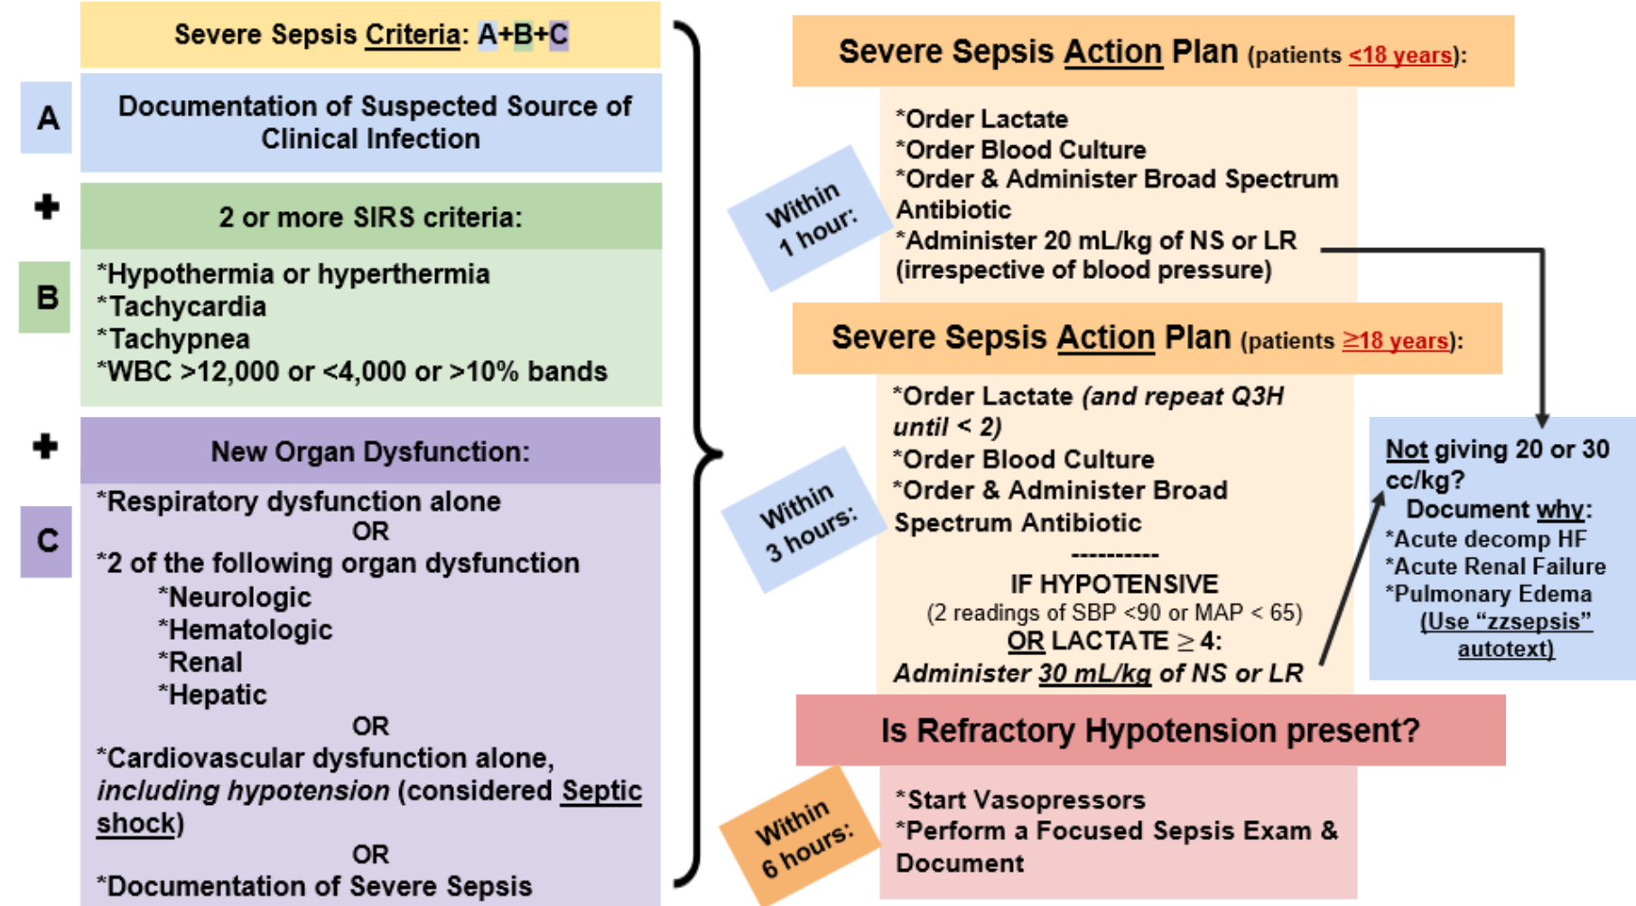

Slide 33
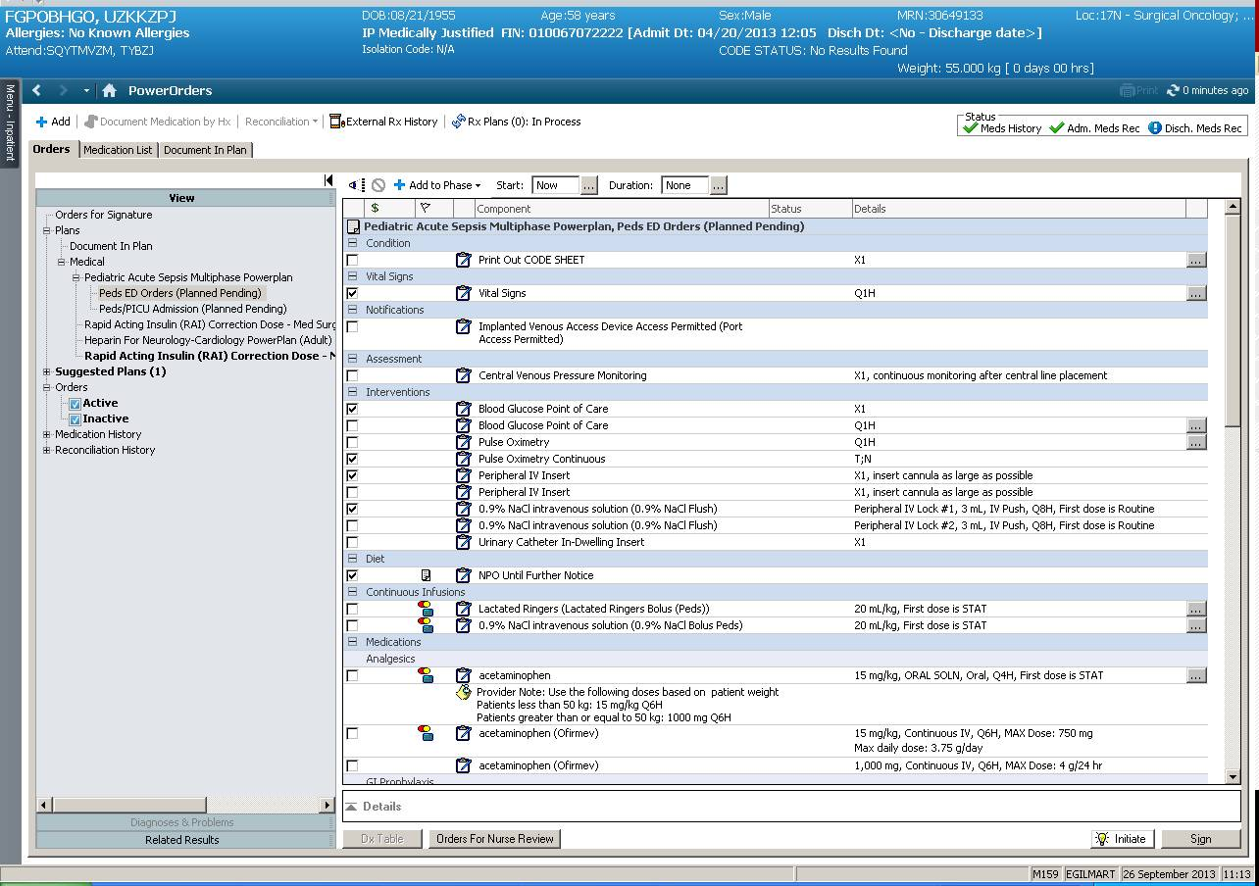
For Patients < 18 years old
Recognition to Immediate Treatment
The Pediatric Acute Sepsis Multiphase Power plan
Early Detection and Treatment of Severe Sepsis
Notes:
Once severe sepsis or septic shock is recognized in a pediatric patient, a multiphase power plan is available in Cerner to facilitate rapid compliance with all of the bundle elements across the different treatment locations, including the ED, the pediatric floor and the PICU. All pediatric bundle elements must be completed within one hour of presentation time.

Slide 34
For Patients < 18 years old
Pediatric Inpatient Severe Sepsis Recognition Pager Workflow
Patient meets severe sepsis criteria
Pager fires location to PICU attending
Page identifies the patient and location of the sepsis alerts
PICU attending speaks with the provider responsible for the patient and asks them to assess the patient
Findings are reviewed by the provider with the PICU attending, and outstanding bundle elements implemented if appropriate
The responsible provider answers the severe sepsis screening alert AND documents findings in SBAR format. This document is forwarded to both the PICU attending and primary attending.
Notes:
When a patient meets severe sepsis criteria
A Page identifies the patient and location of the sepsis alert to the PICU attending.
The PICU attending speaks with the provider responsible for the patient and asks them to assess the patient.
Findings are reviewed by the provider with the PICU attending, and outstanding bundle elements implemented if appropriate.
The responsible provider answers the severe sepsis screening alert AND documents findings in SBAR format. This document is forwarded to both the PICU attending and primary attending.

Slide 35
In Summary…
Early recognition is essential for the management of severe sepsis
Lactate is an early predictor of organ dysfunction and prognostic marker
Early fluid resuscitation and administration of antibiotics is critical!
Sepsis Powerplans and Caresets are available and guide LIPs
It is the responsibility of the primary team to answer alerts in a timely fashion and ensure compliance
Notes:
To summarize, early recognition and management of severe sepsis and septic shock is essential to improve outcomes. Lactate is an early predictor of organ dysfunction. Early fluid resuscitation and administration of antibiotics are critical. Sepsis Powerplans and Caresets are available to facilitate early appropriate management.
The use of the sepsis protocol has improved our patient outcomes.

Slide 36
LMS Questions
If not already initiated, which bundle elements must be initiated within 3 hours of severe sepsis presentation?
Lactate Level
Blood culture and broad spectrum antibiotic
Initiation of fluid resuscitation with any instance of hypotension
All of the above
A patient is considered to have septic shock if they have a lactic acid result ≥4 mmol/L within 6 hours of severe sepsis presentation. T/F?
What is the initial fluid requirement for an adult with severe sepsis and initial hypotension or septic shock?
20 mL/kg/hr crystalloid fluids
30 mL/kg/hr crystalloid fluids
20 mL/kg/hr crystalloid fluids or colloid fluids
30 mL/kg/hr crystalloid fluids or colloid fluids
4. When must a lactate level be redrawn if the initial result was >2 mmol/L?
Within 2 hours of severe sepsis presentation
Within 4 hours of severe sepsis presentation
Within 6 hours of severe sepsis presentation
Lactate level does not need to be repeated
The physician/advanced practitioner must document that he/she has reviewed, performed or attested to reviewing or performing a cardiopulmonary reassessment after the initiation of crystalloid fluids but no later than 6 hours after the presentation of septic shock. T/F?
The first dose of a broad spectrum antibiotic for the treatment of severe sepsis/septic shock is available for override in the Pyxis on all nursing units. T/F?

Slide 37
References
Dellinger, R. Phillip et al, Surviving Sepsis Campaign: International Guidelines for Management of Severe Sepsis and Septic Shock: 2012. Critical Care Medicine, Feb. 2013. Vol. 41, No.2.
Goldstein, Brahm, et al, International Pediatrics Sepsis Consensus Conference: Definitions for sepsis and organ dysfunction in Pediatrics. Pediatric Critical Care Medicine, 2005, Vol.6 No. 1.
Surviving Sepsis Campaign: An international collaborative recommending resuscitation and management care bundles for the recognition and treatment of sepsis/septic shock. Recommendations were first published as in Critical Care Medicine, Mar 2004.
Link to Policy
SBUH PC0169 Severe Sepsis/Septic Shock Recognition and Treatment Protocols – Adult and Pediatric
https://policymanager.uhmc.sunysb.edu/dotNet/documents/?docid=21977

